Slide 1
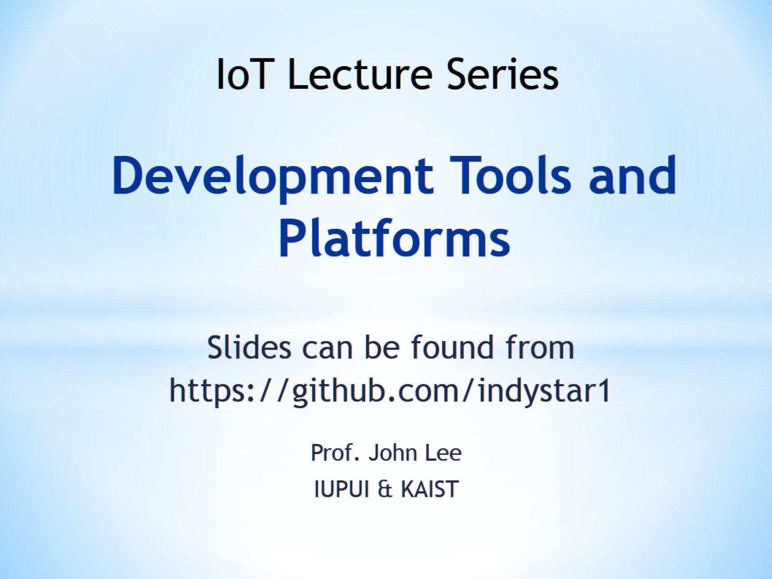
Development Tools and Platforms

Slide 2
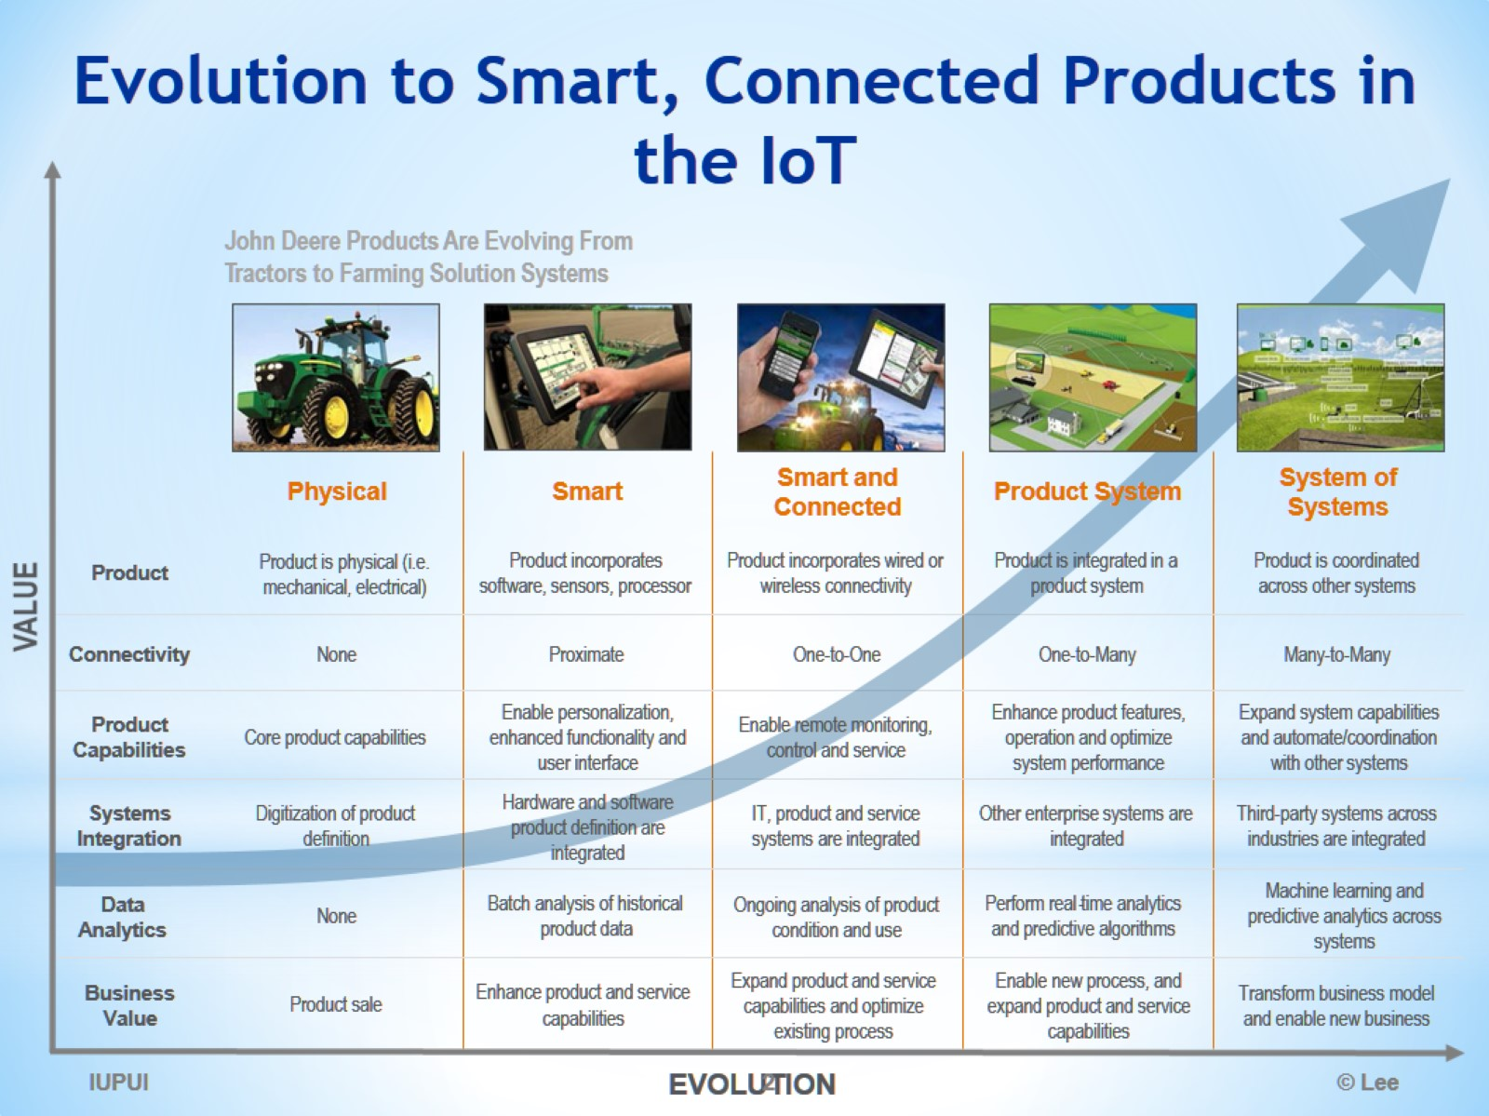
Evolution to Smart, Connected Products in the IoT

Slide 3
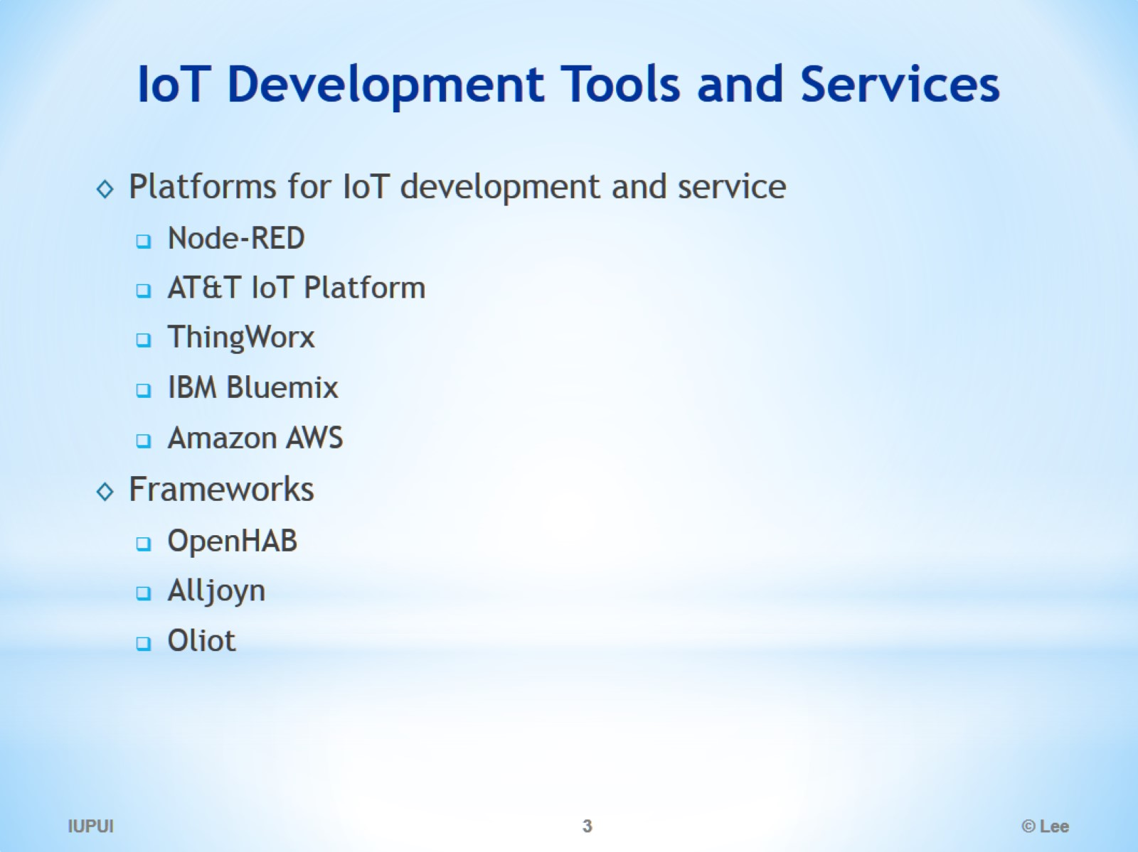
IoT Development Tools and Services

Slide 4
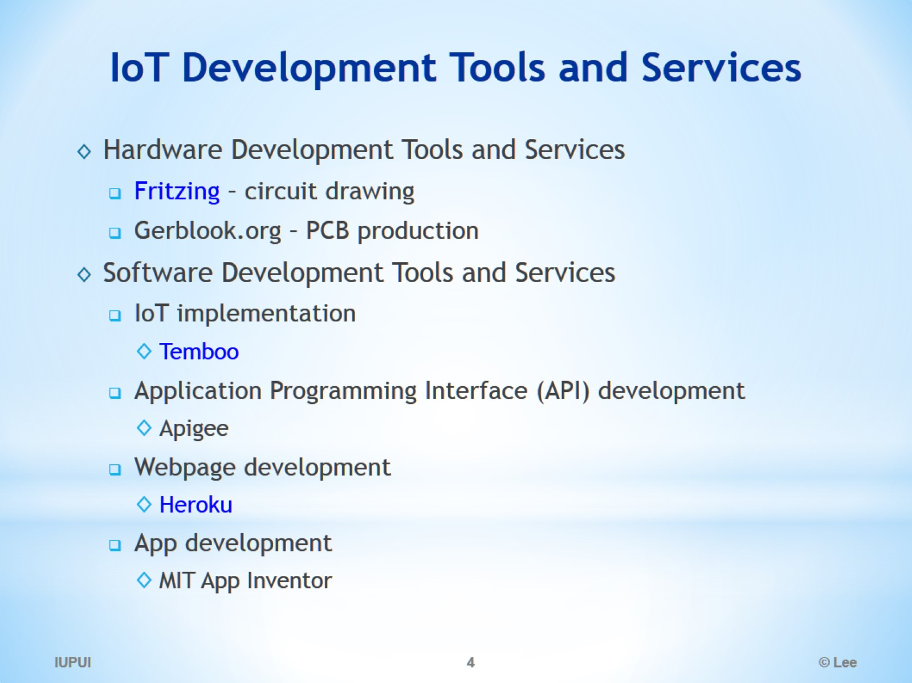
IoT Development Tools and Services

Slide 5
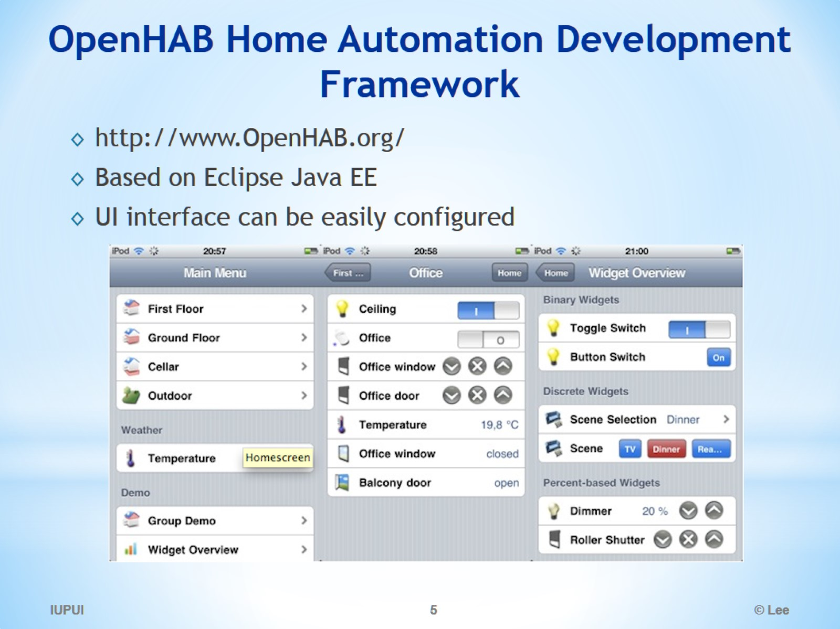
OpenHAB Home Automation Development Framework

Slide 6
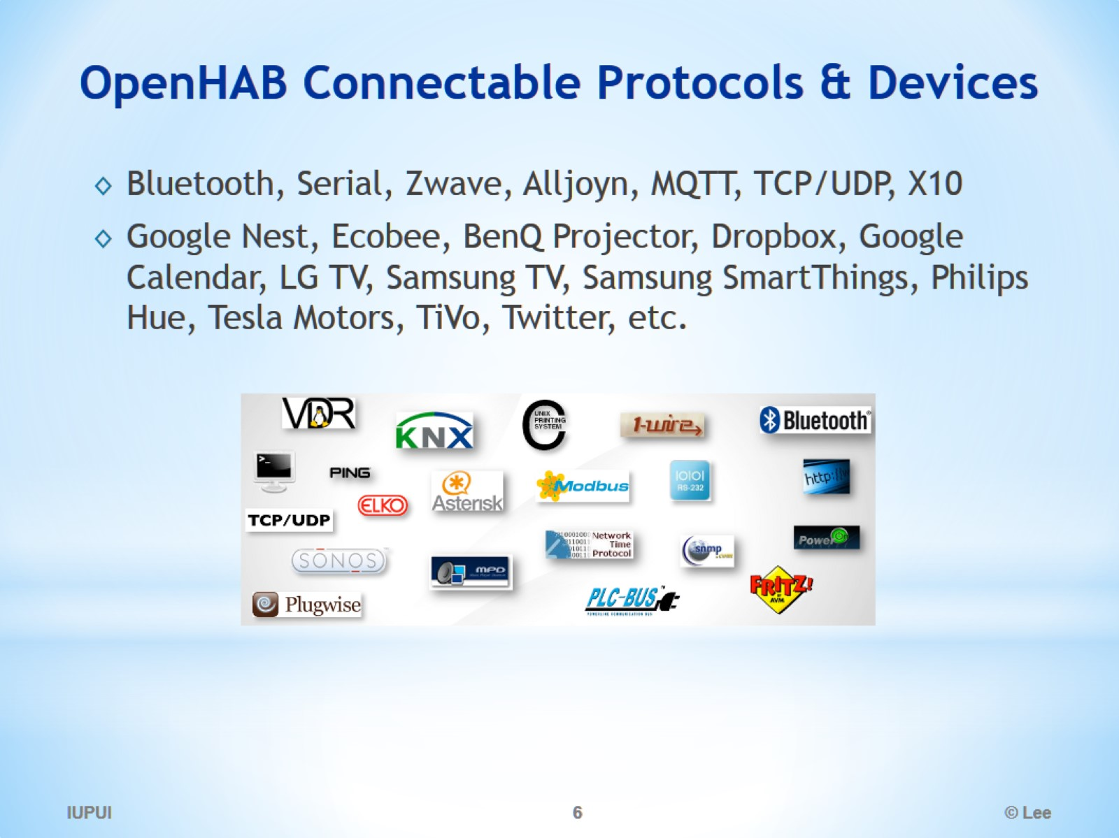
OpenHAB Connectable Protocols & Devices

Slide 7
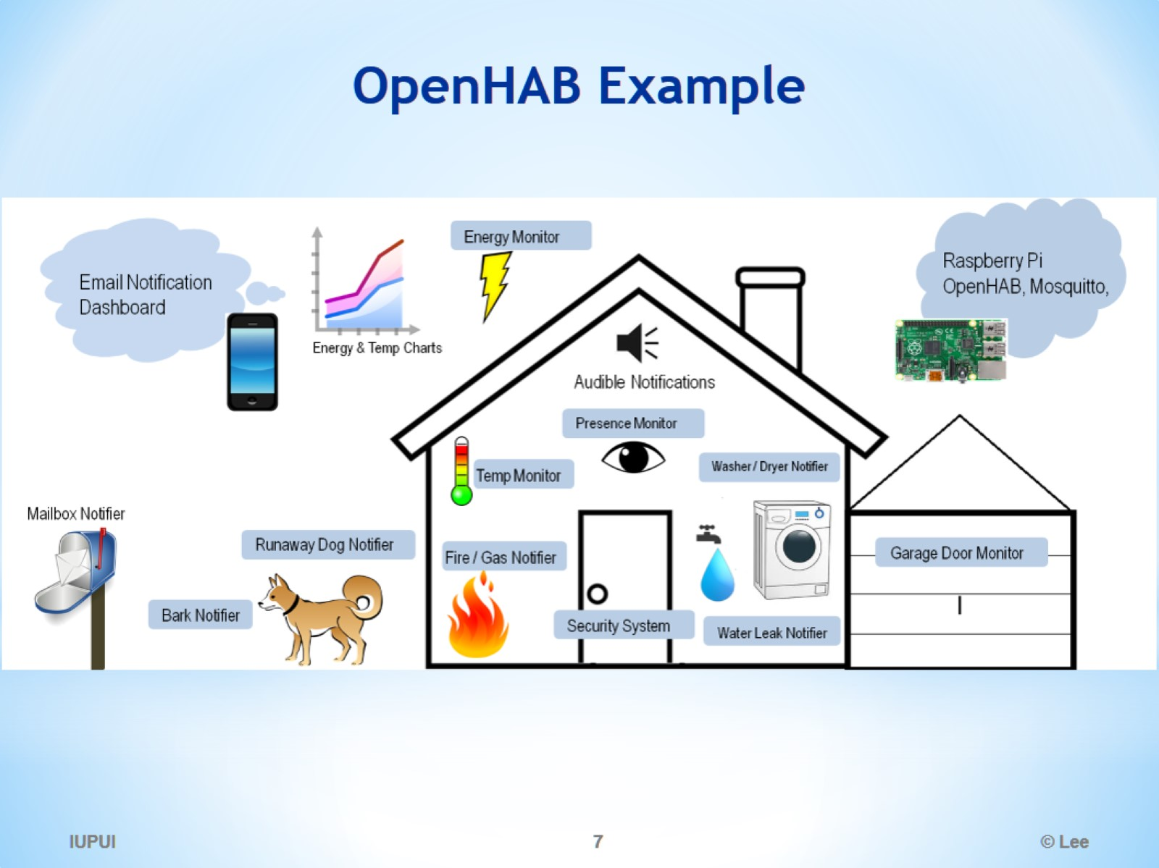
OpenHAB Example

Slide 8
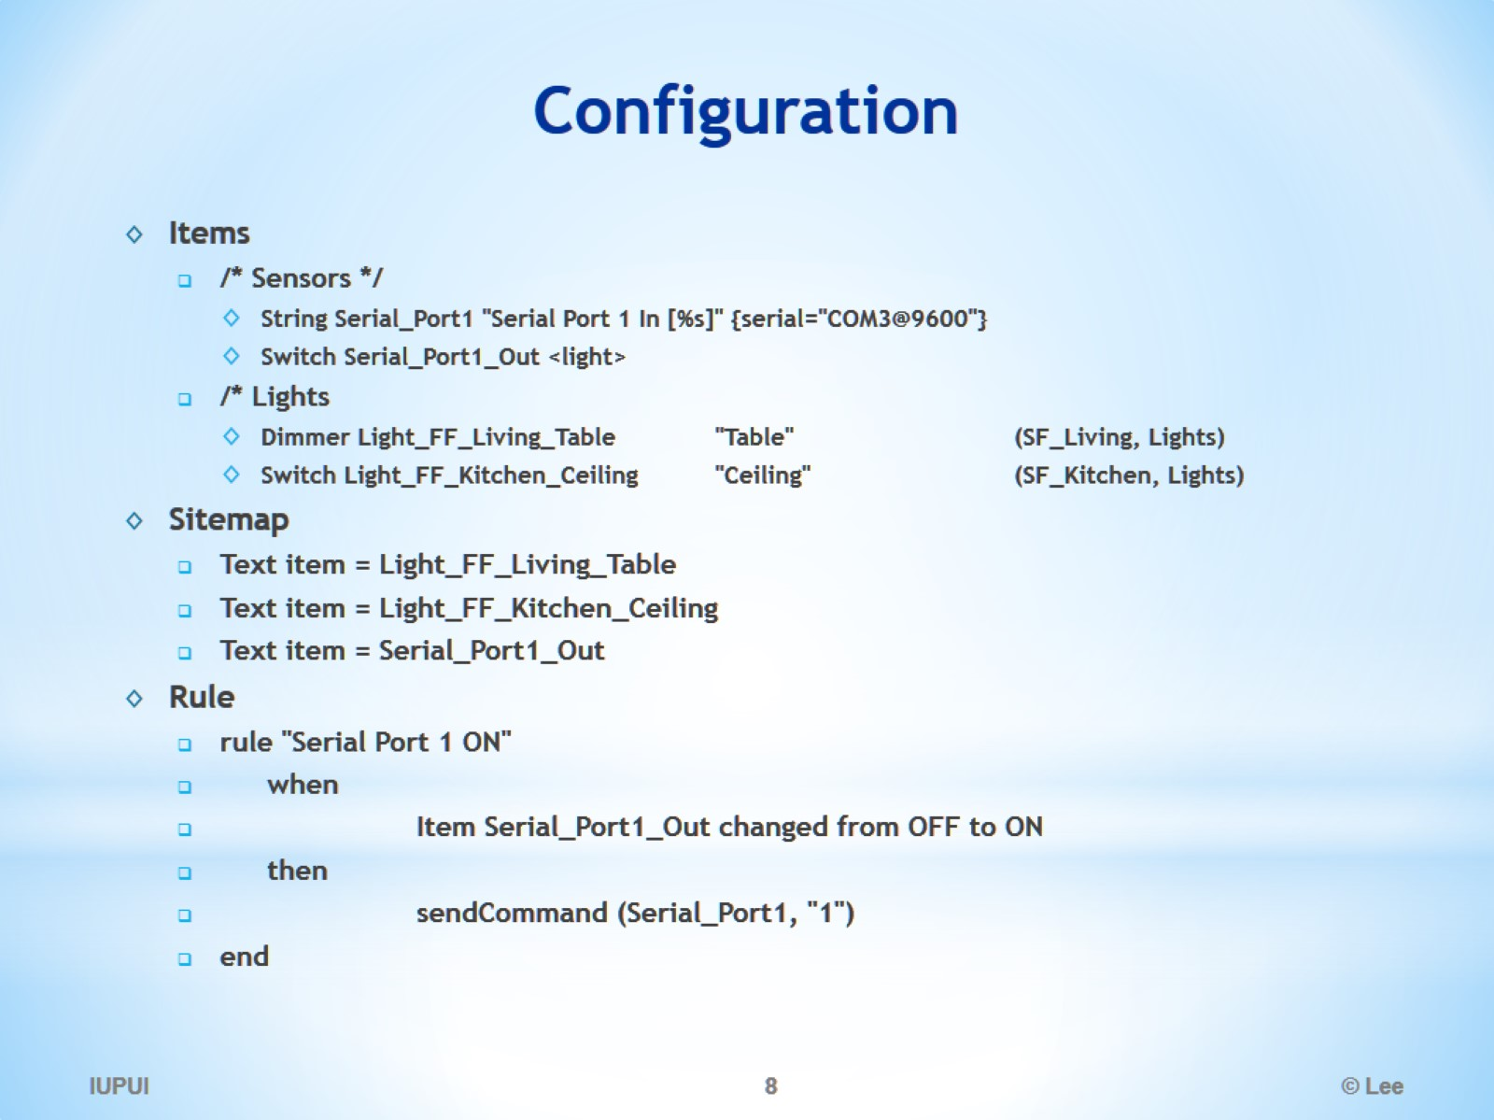
Configuration

Slide 9
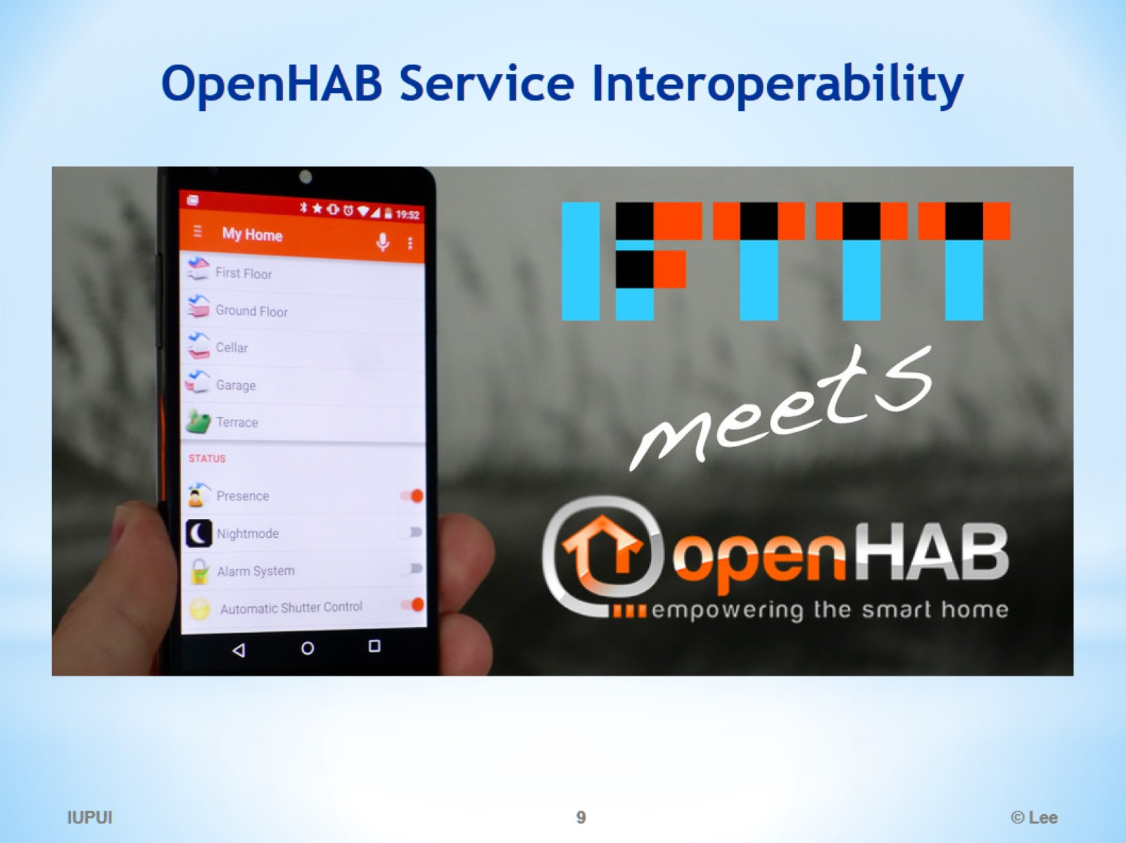
OpenHAB Service Interoperability

Slide 10
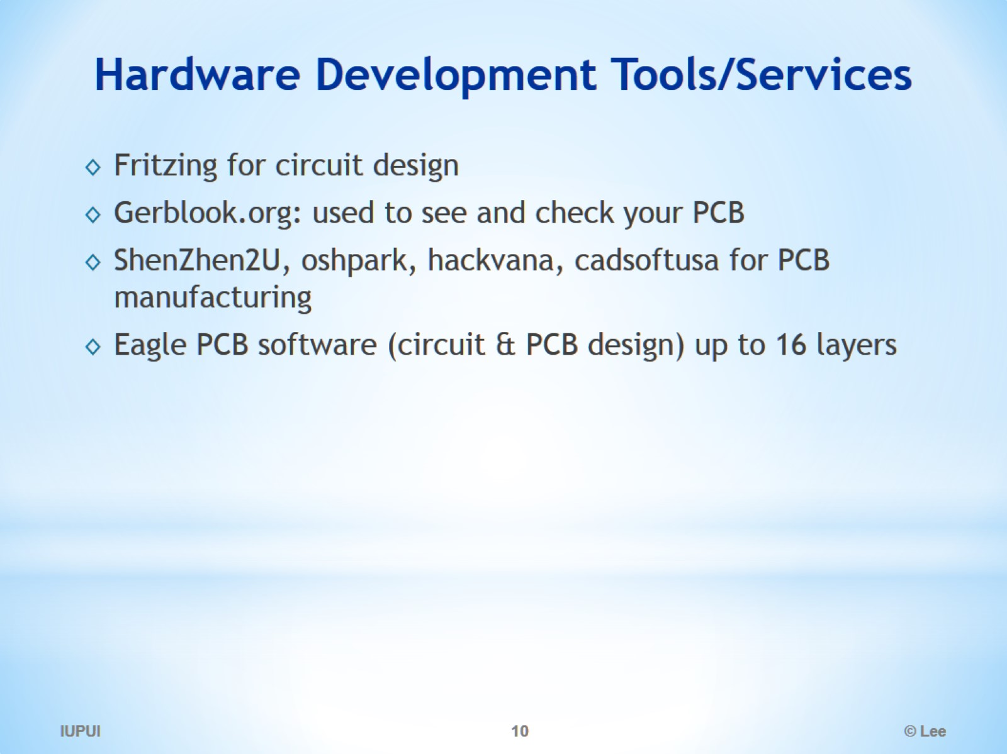
Hardware Development Tools/Services

Slide 11
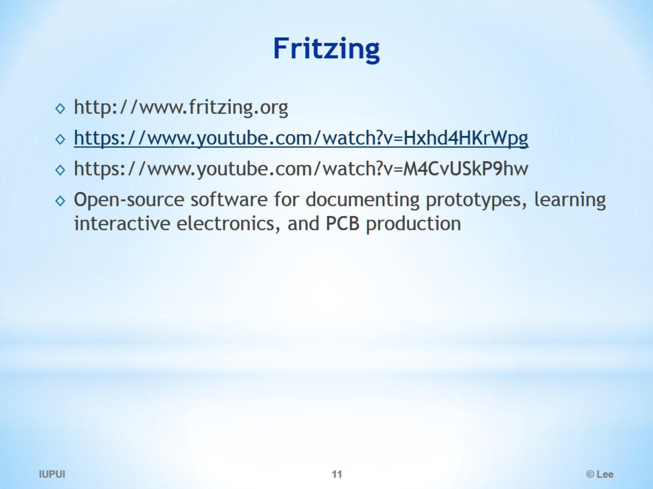
Fritzing

Slide 12
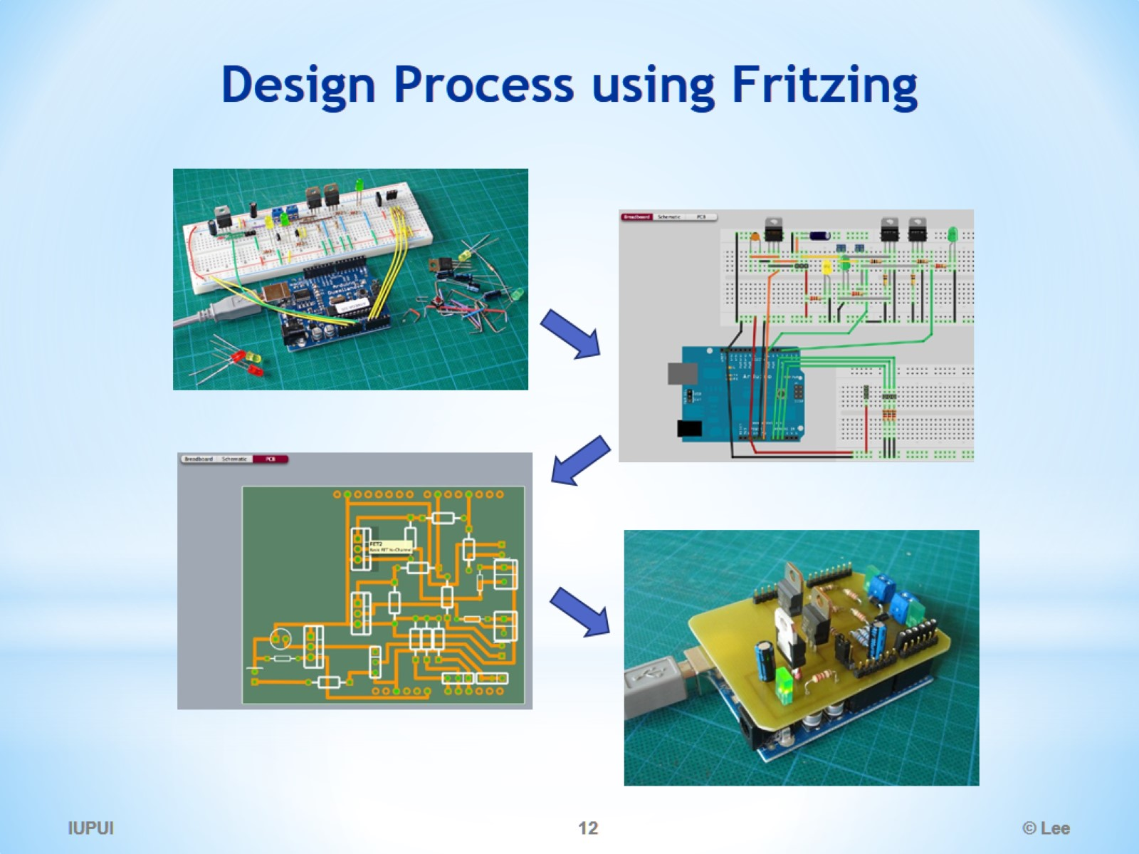
Design Process using Fritzing

Slide 13
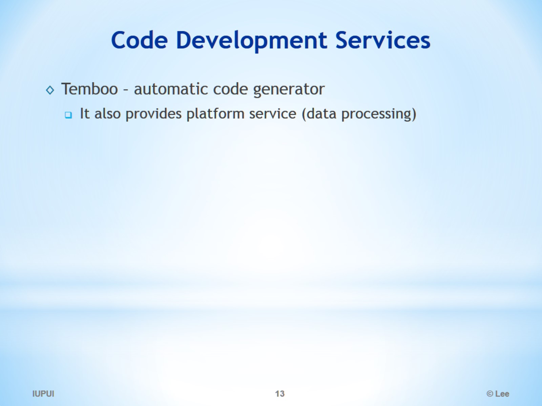
Code Development Services

Slide 14
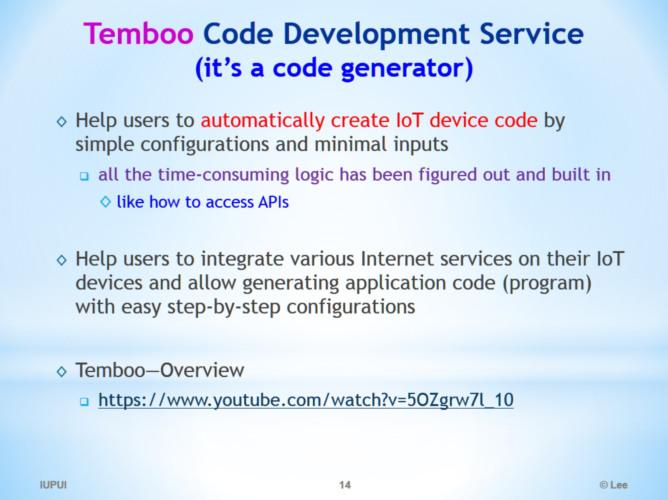
Temboo Code Development Service (it’s a code generator)

Slide 15
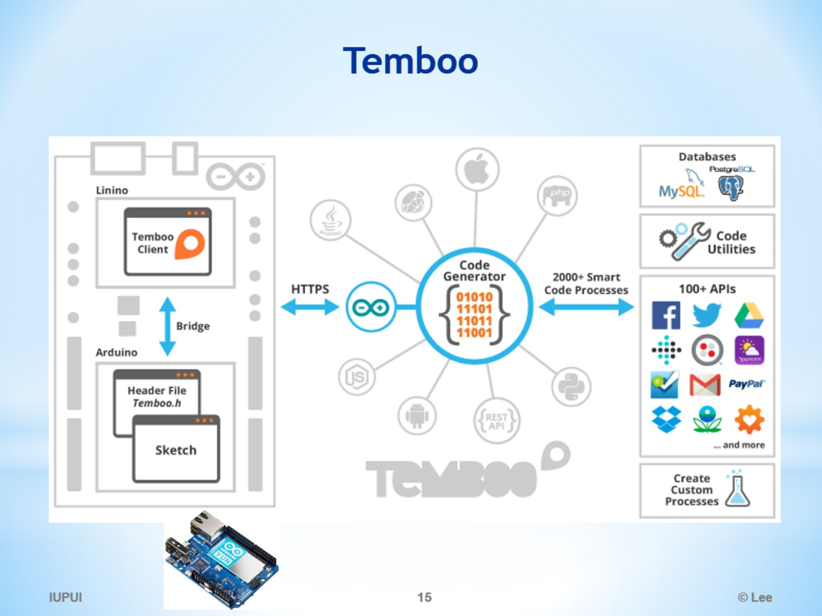
Temboo

Slide 16
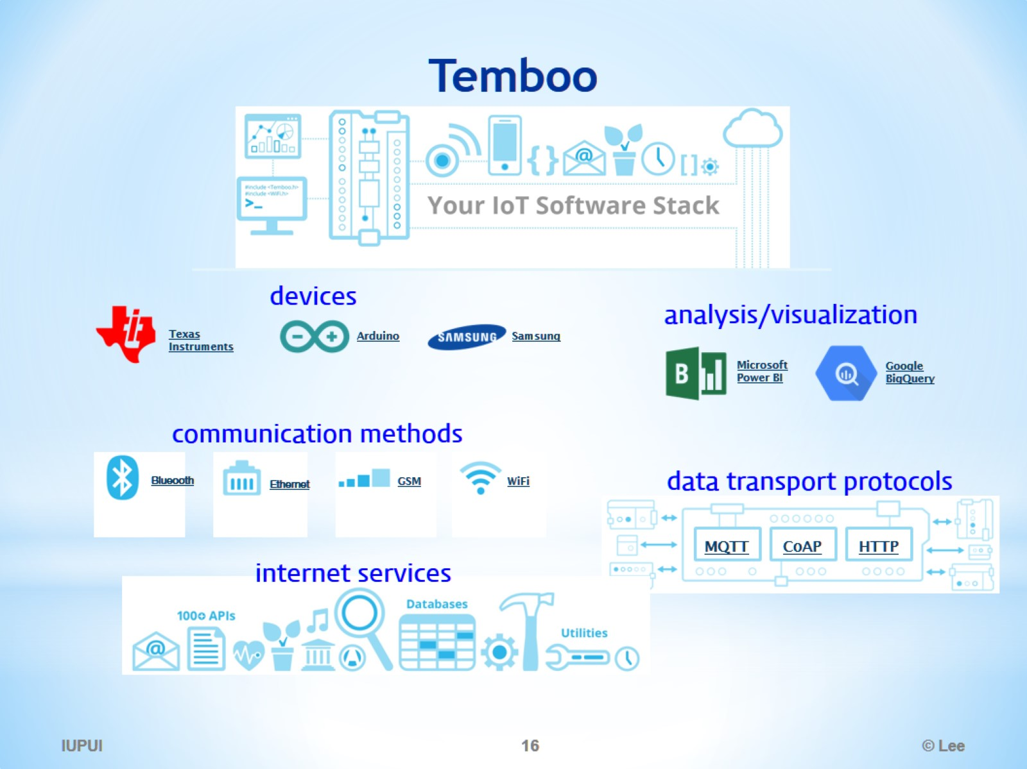
Temboo

Slide 17
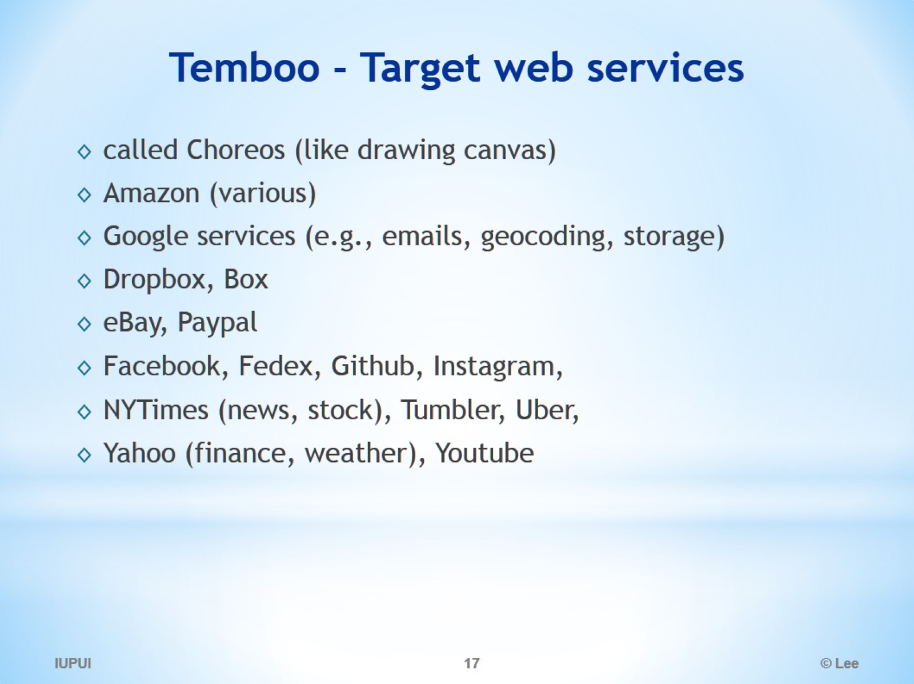
Temboo - Target web services

Slide 18
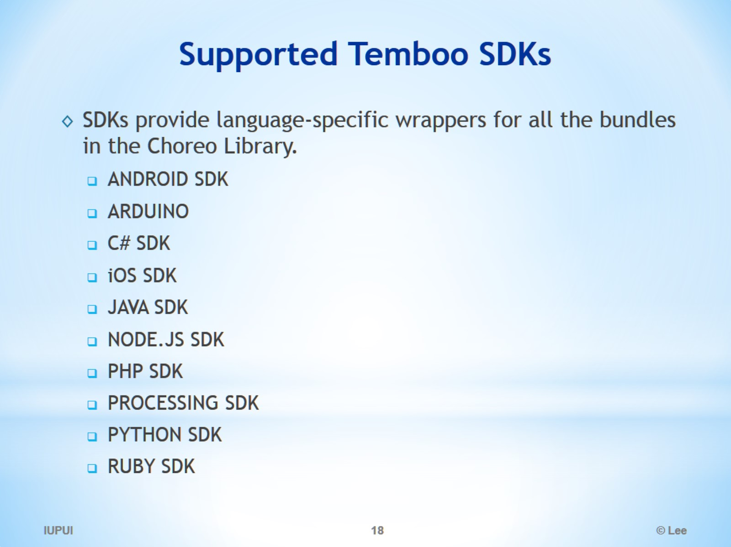
Supported Temboo SDKs

Slide 19
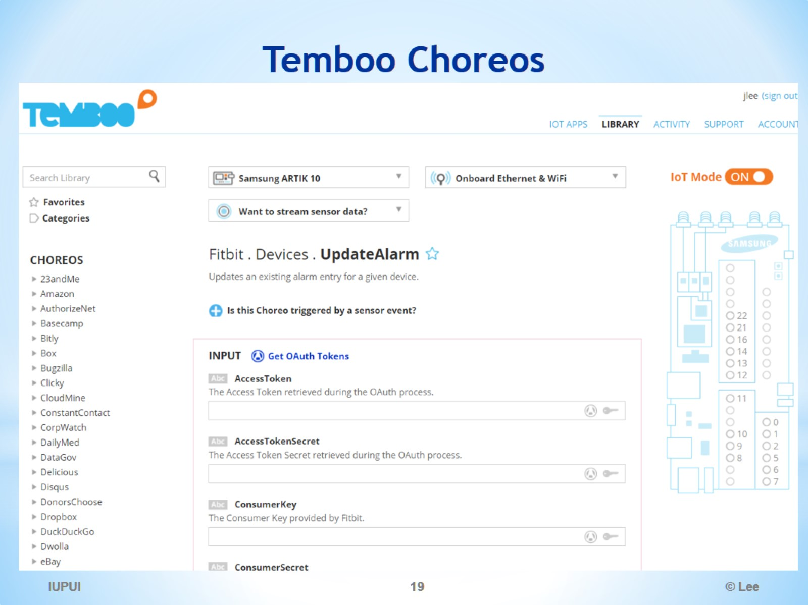
Temboo Choreos

Slide 20
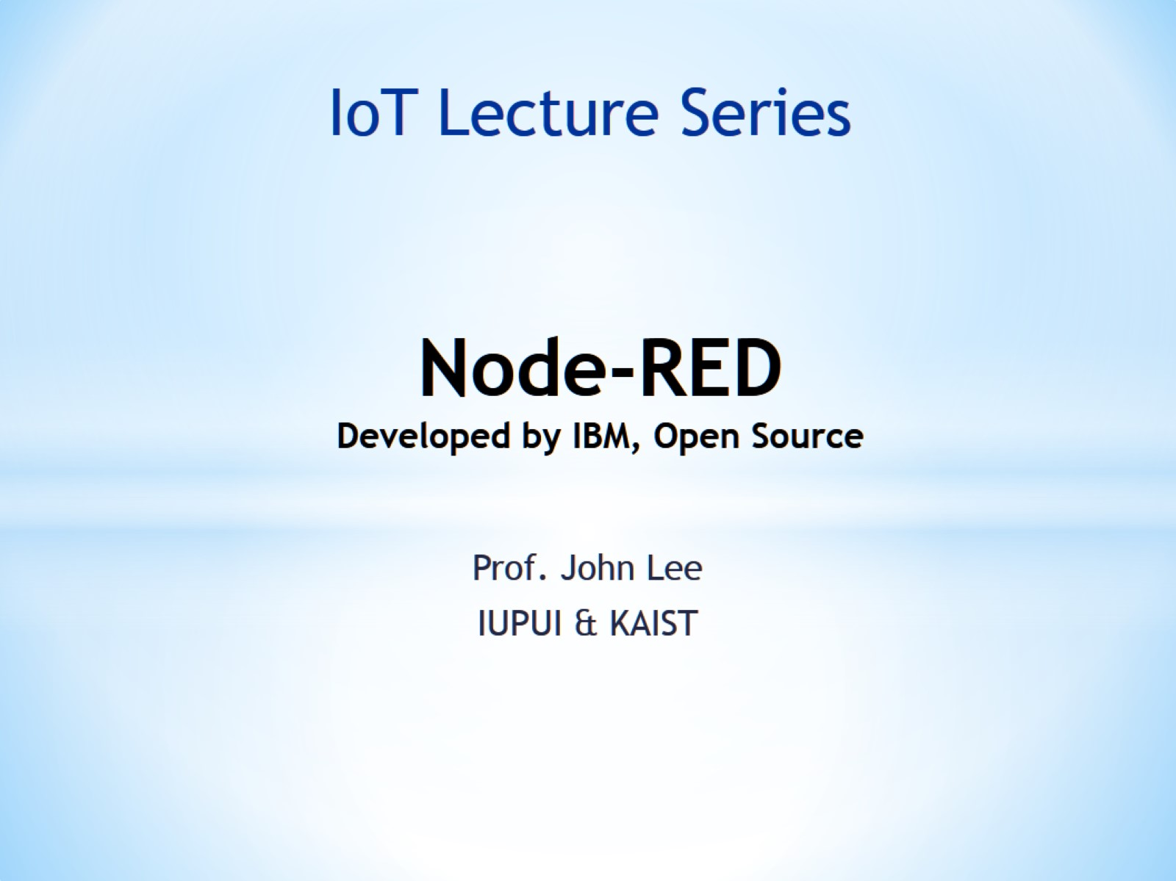
Node-RED Developed by IBM, Open Source

Slide 21
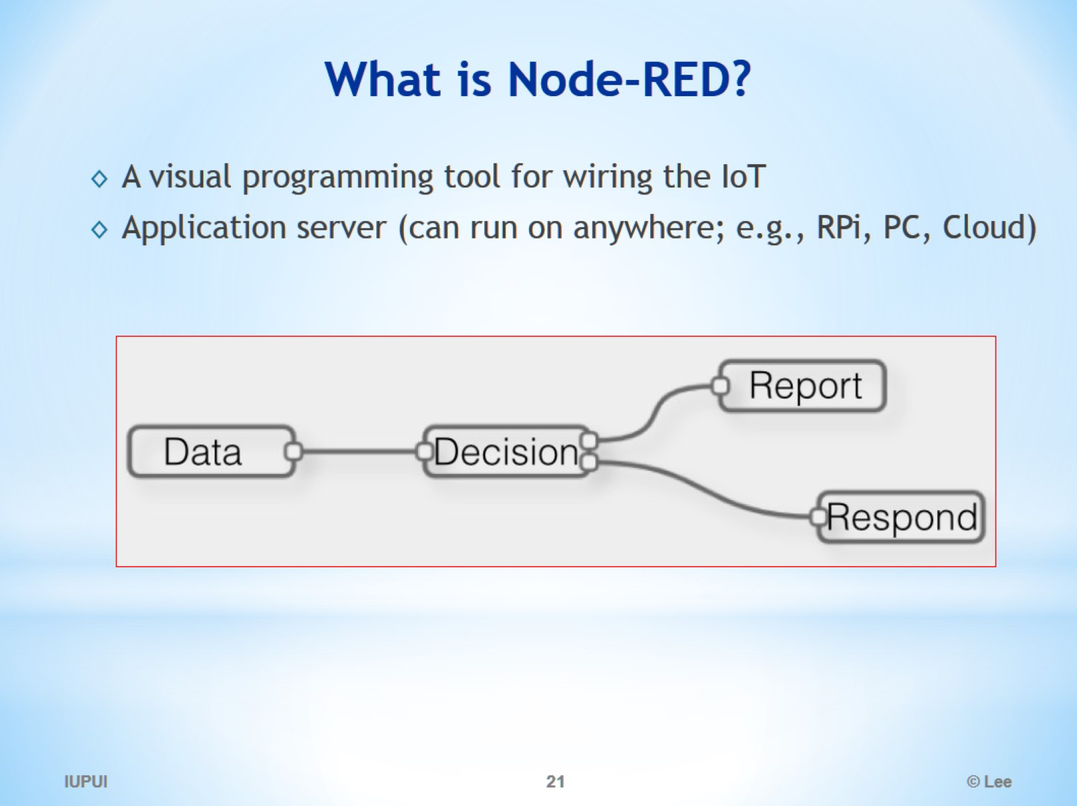
What is Node-RED?

Slide 22
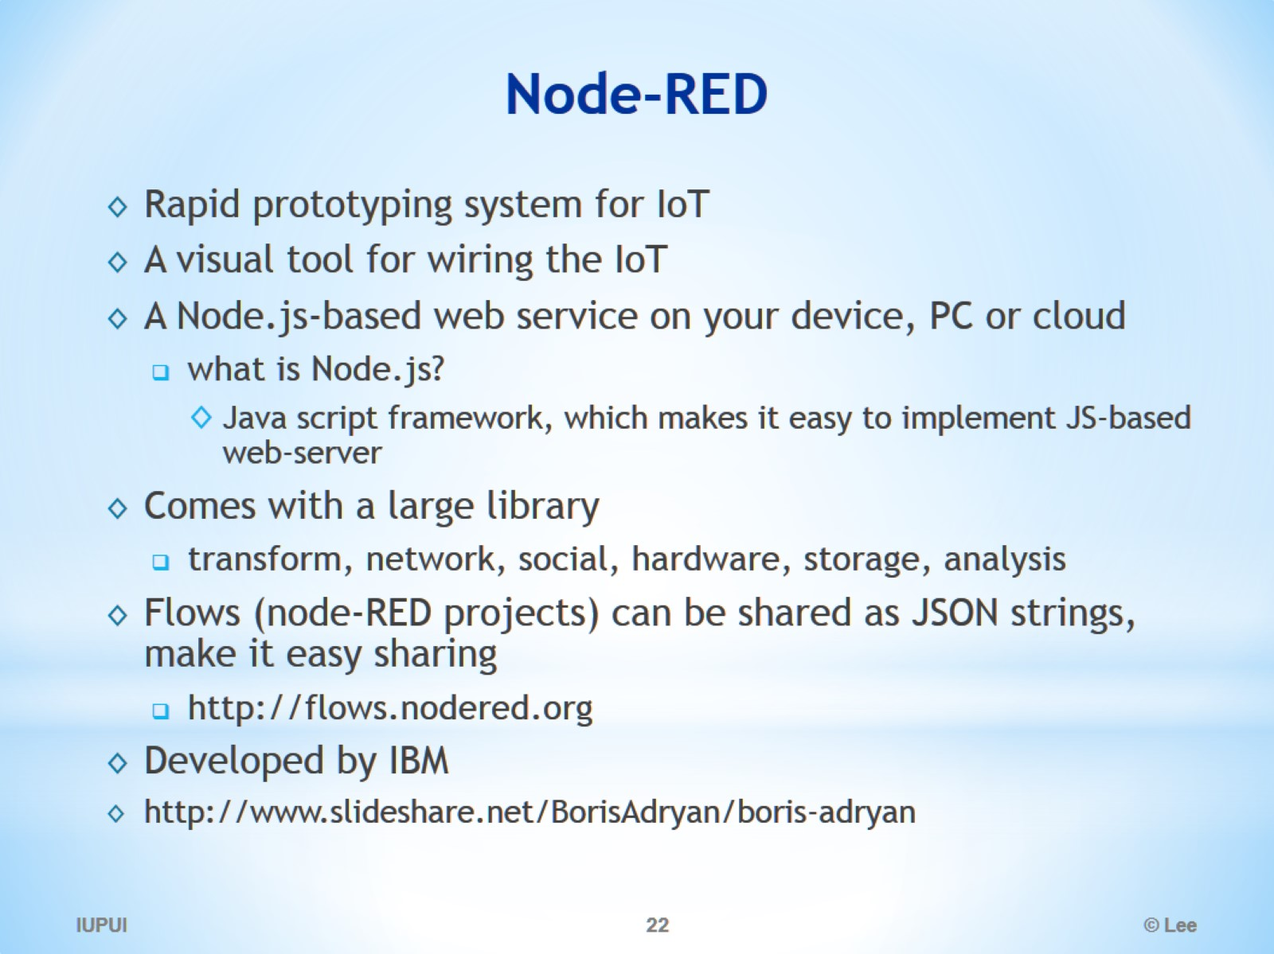
Node-RED

Slide 23
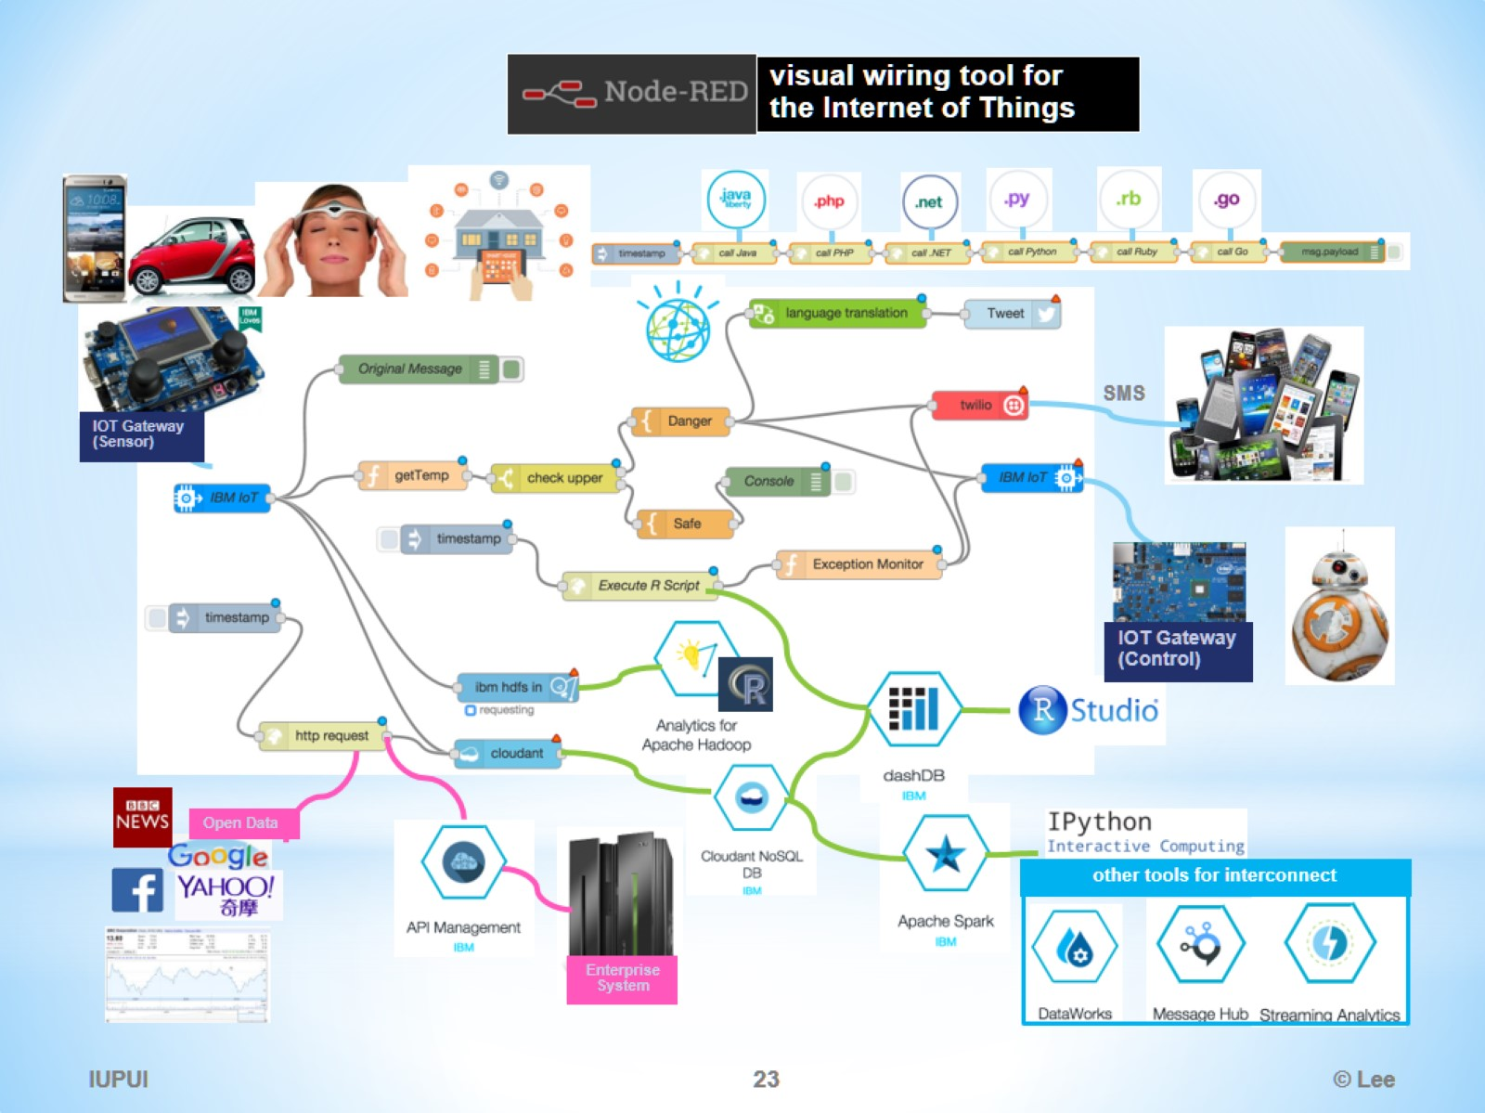

Slide 24
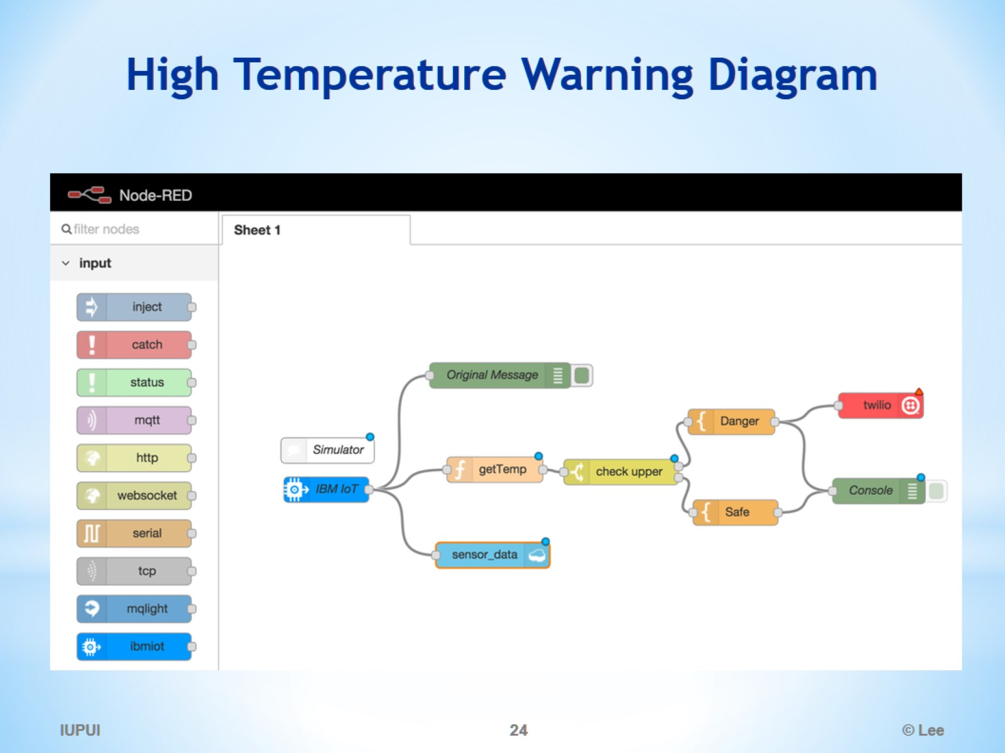
High Temperature Warning Diagram

Slide 25
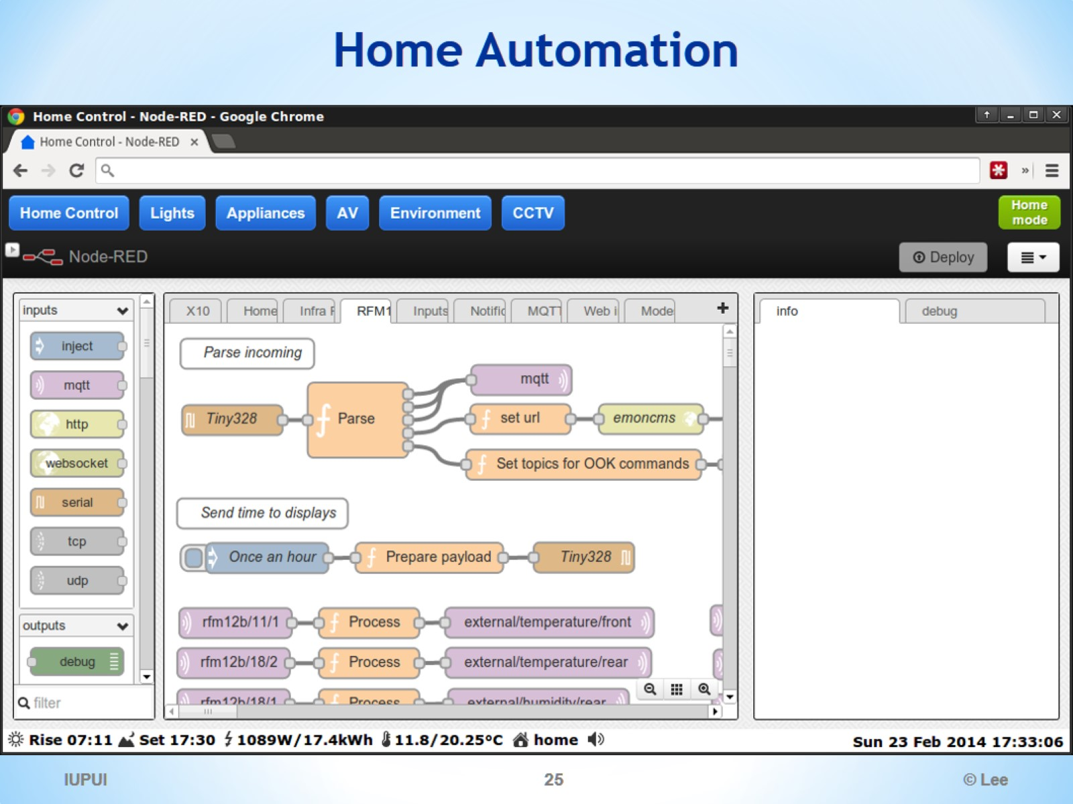
Home Automation

Slide 26
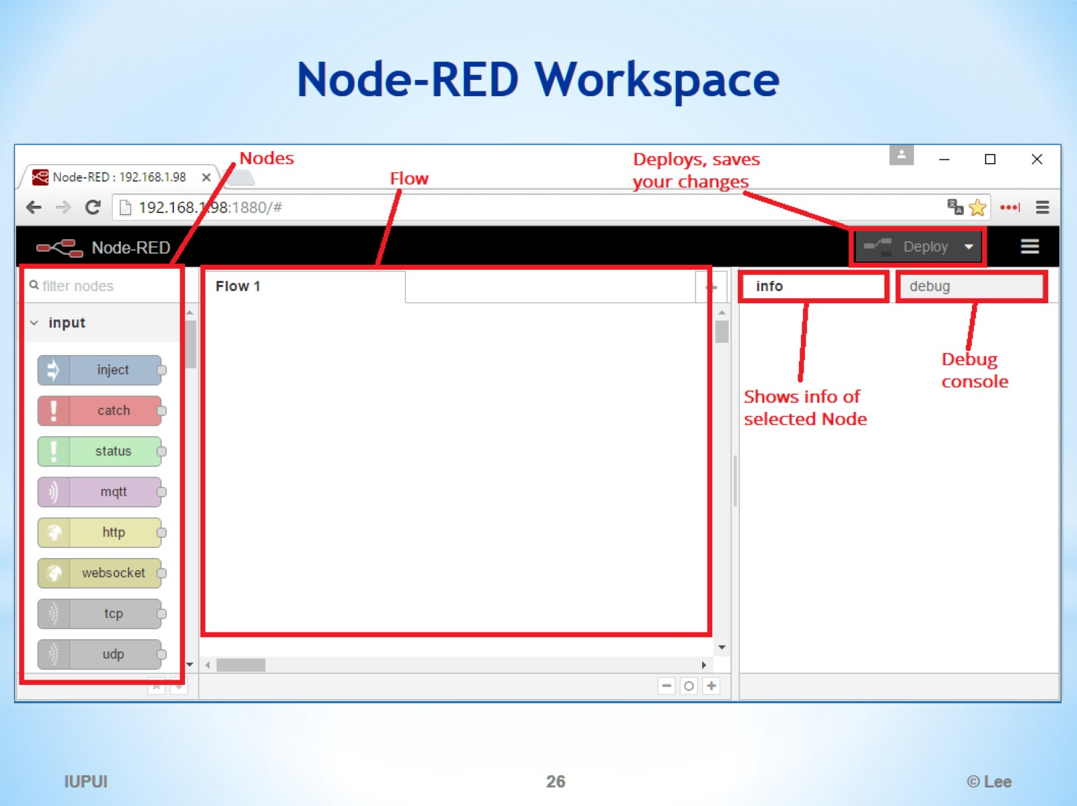
Node-RED Workspace

Slide 27
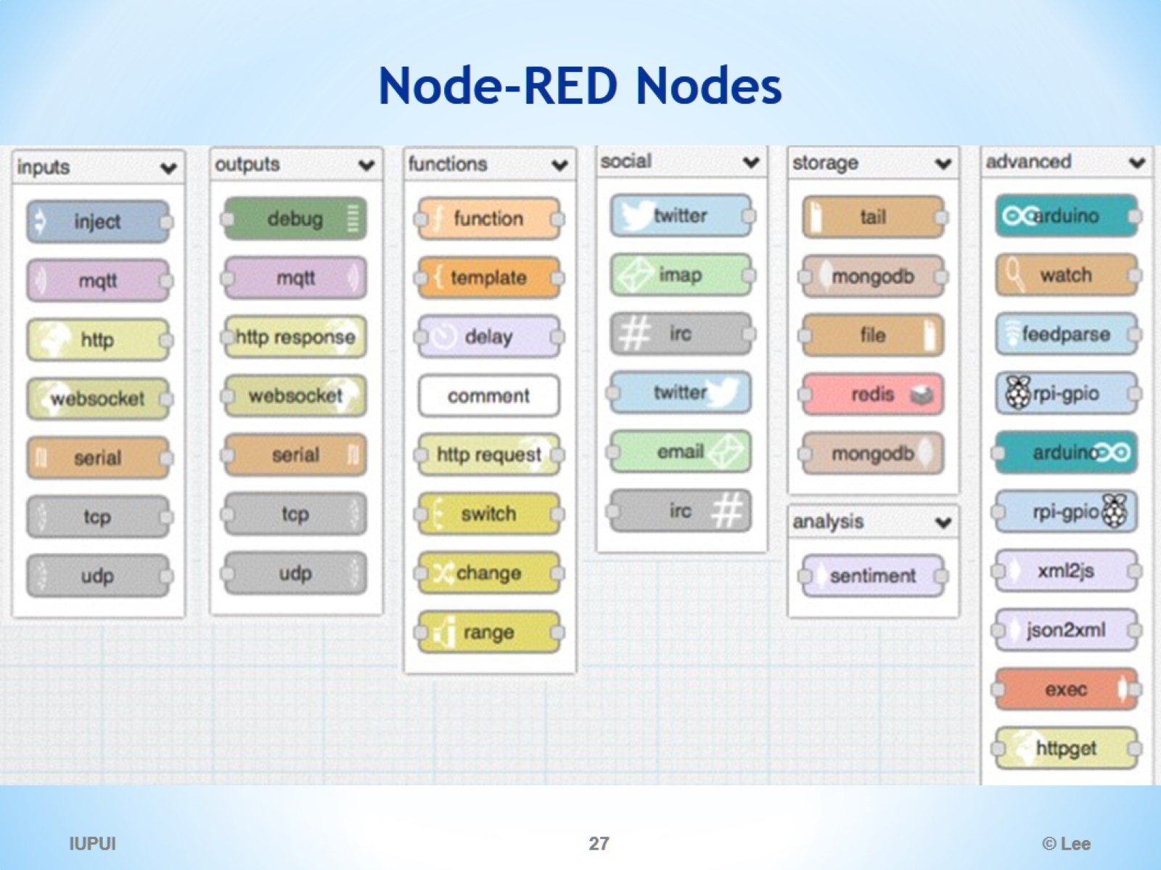
Node-RED Nodes

Slide 28
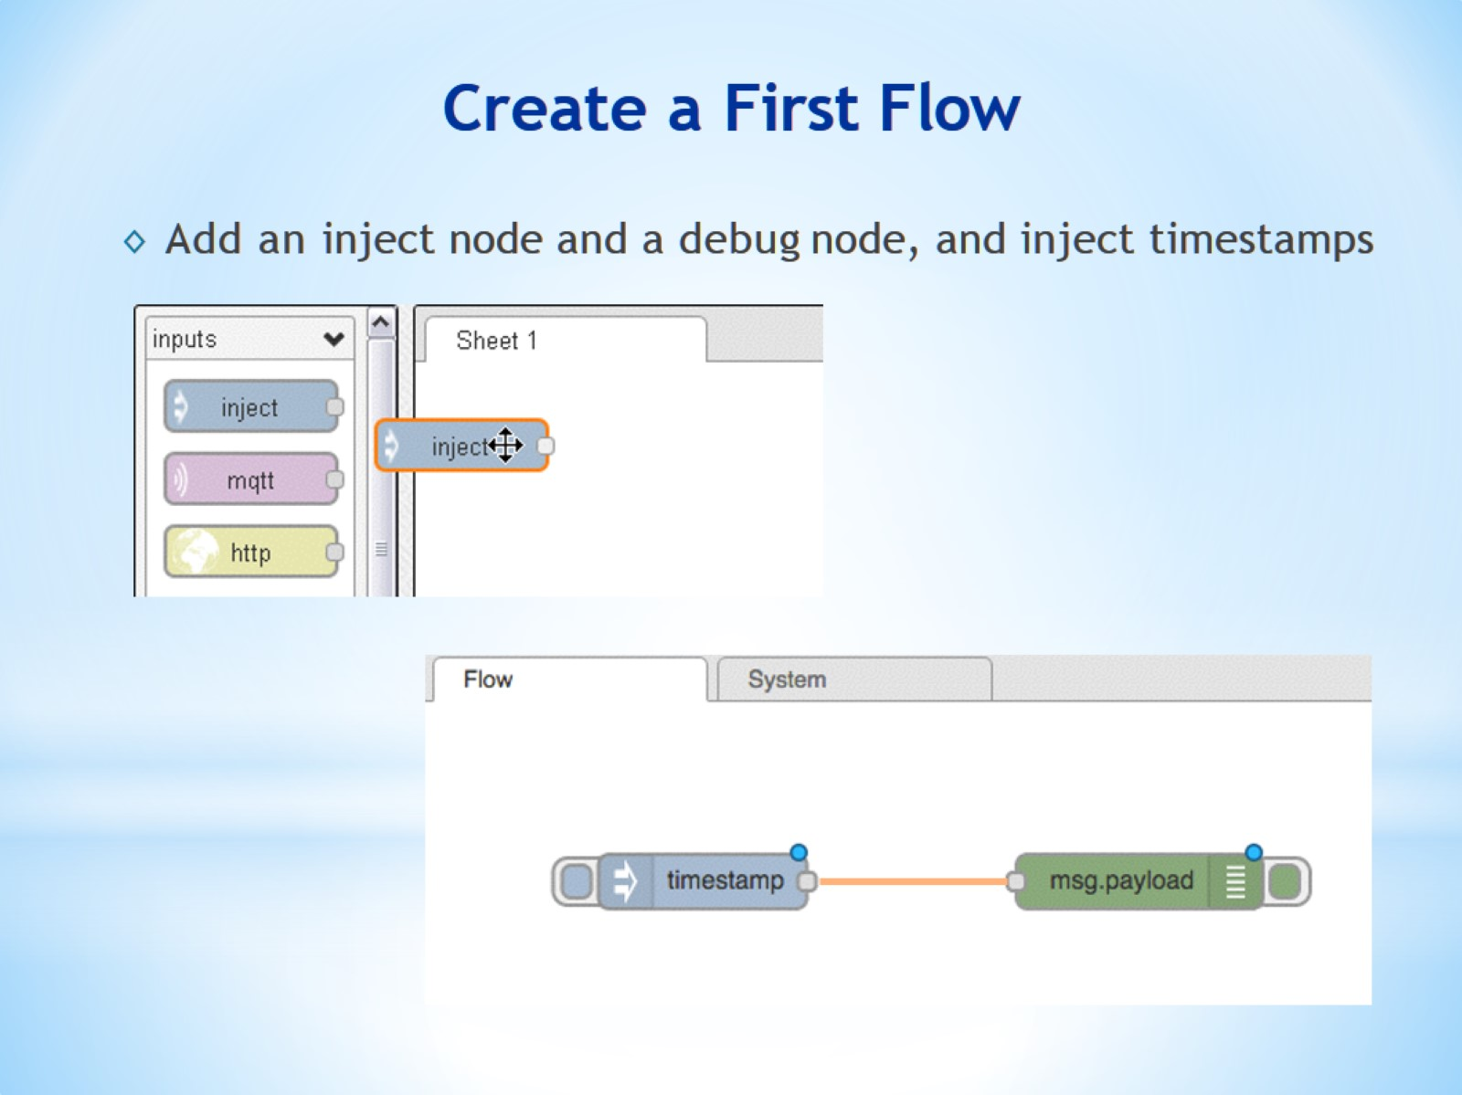
Create a First Flow

Slide 29
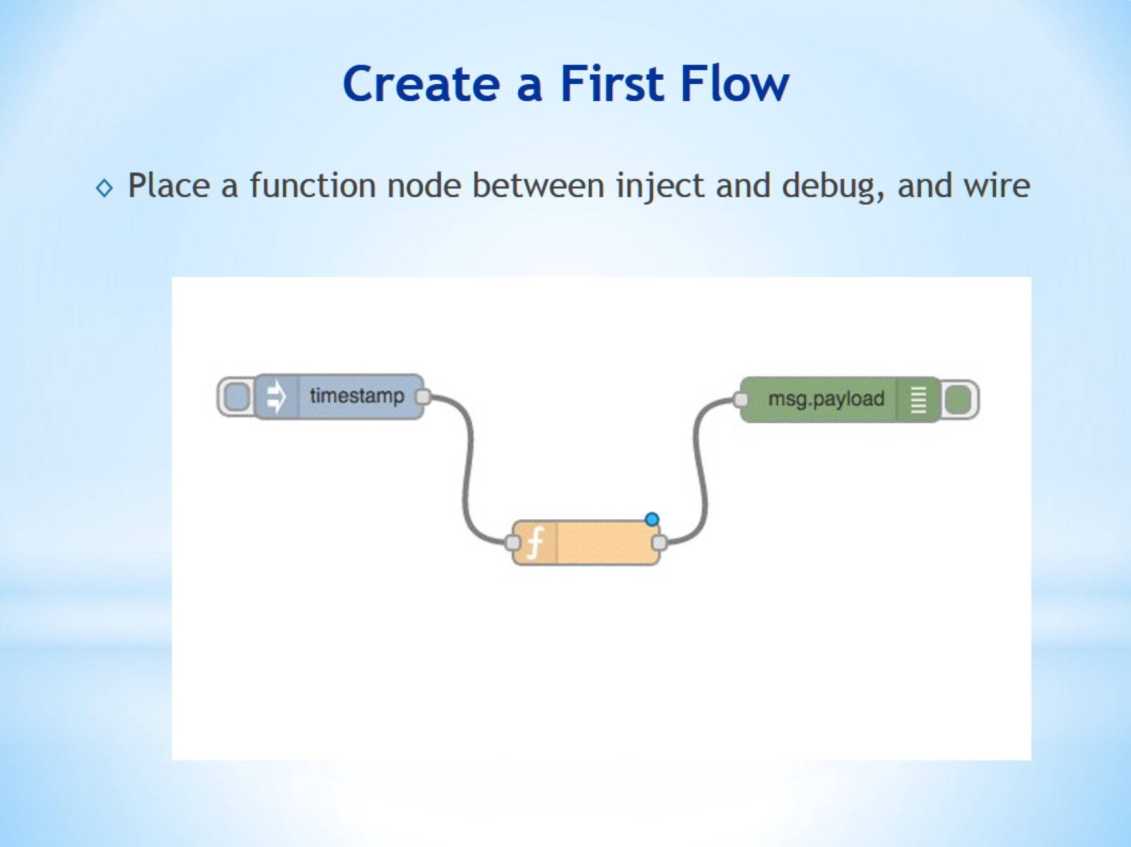
Create a First Flow

Slide 30
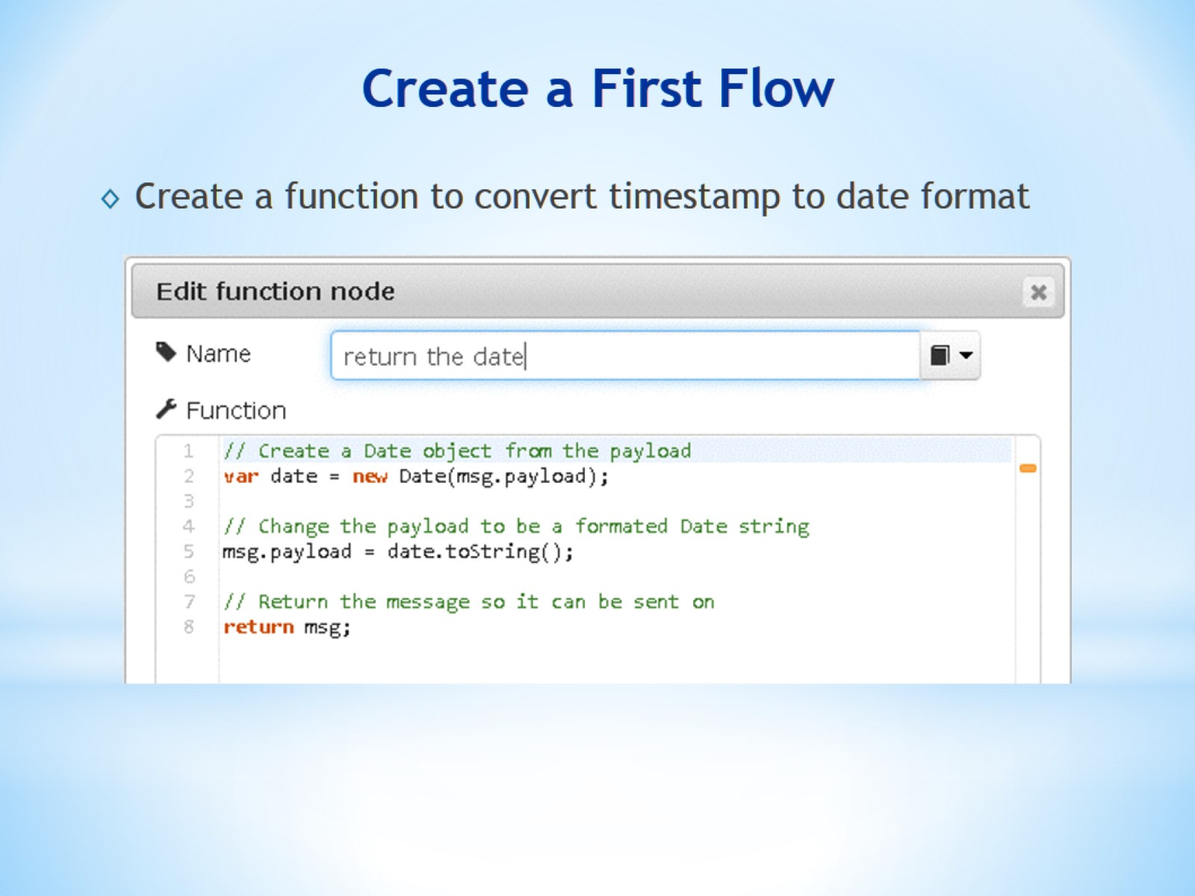
Create a First Flow

Slide 31
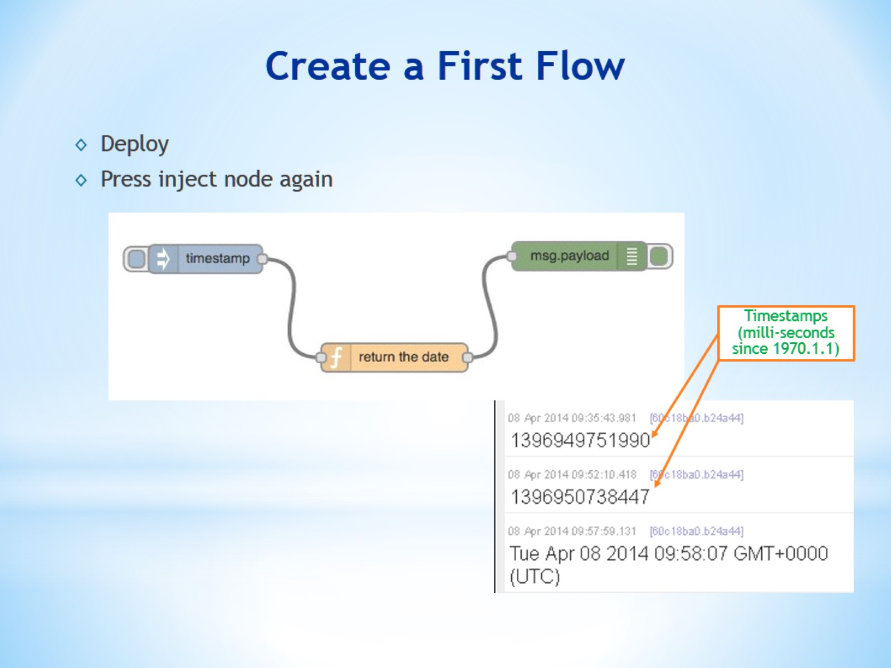
Create a First Flow

Slide 32
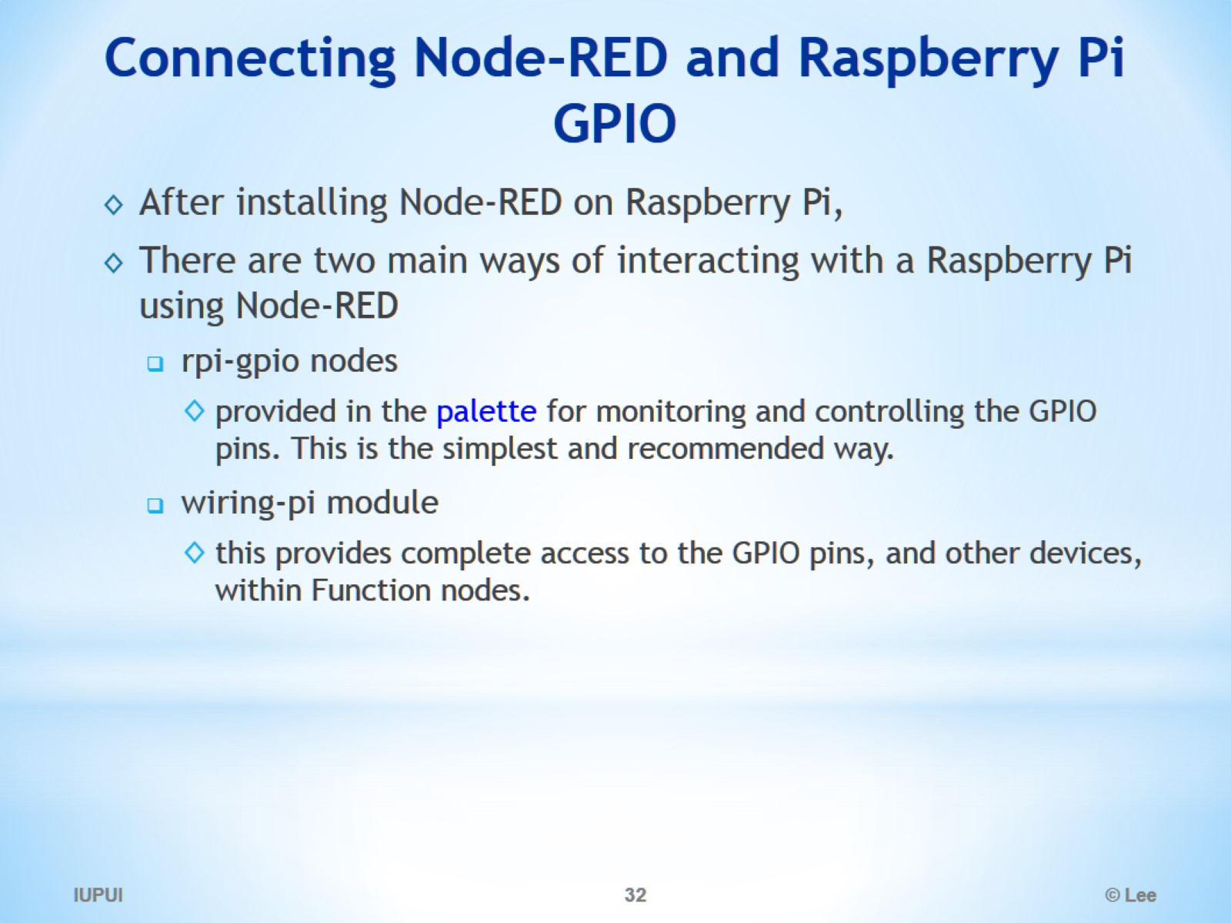
Connecting Node-RED and Raspberry Pi GPIO

Slide 33
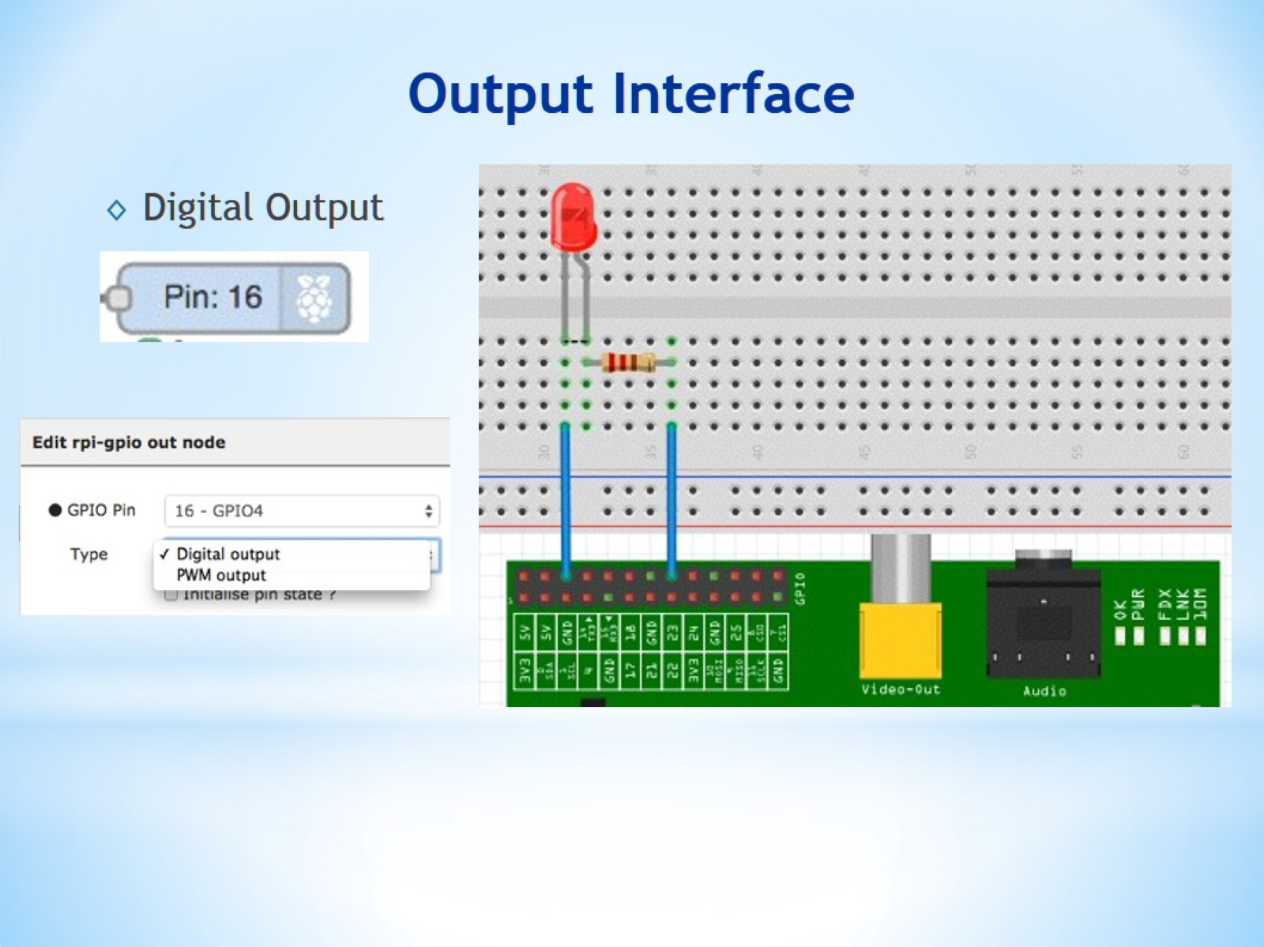
Output Interface

Slide 34
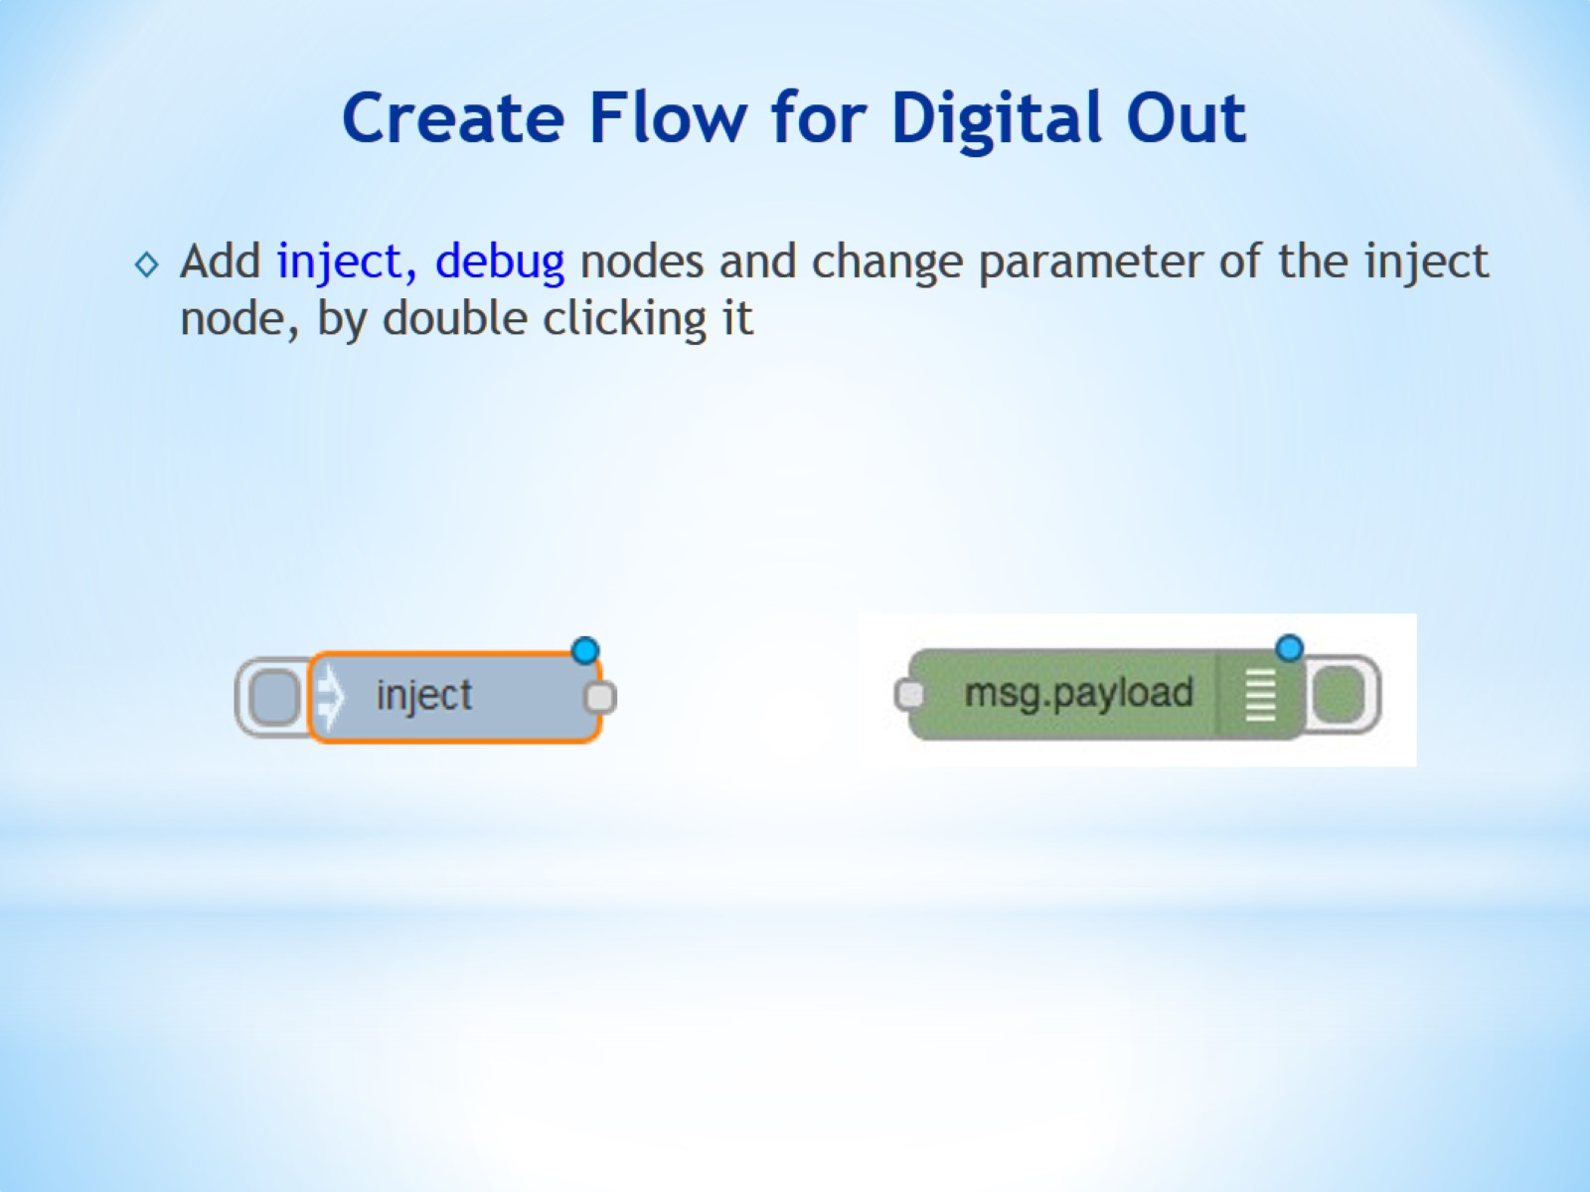
Create Flow for Digital Out

Slide 35
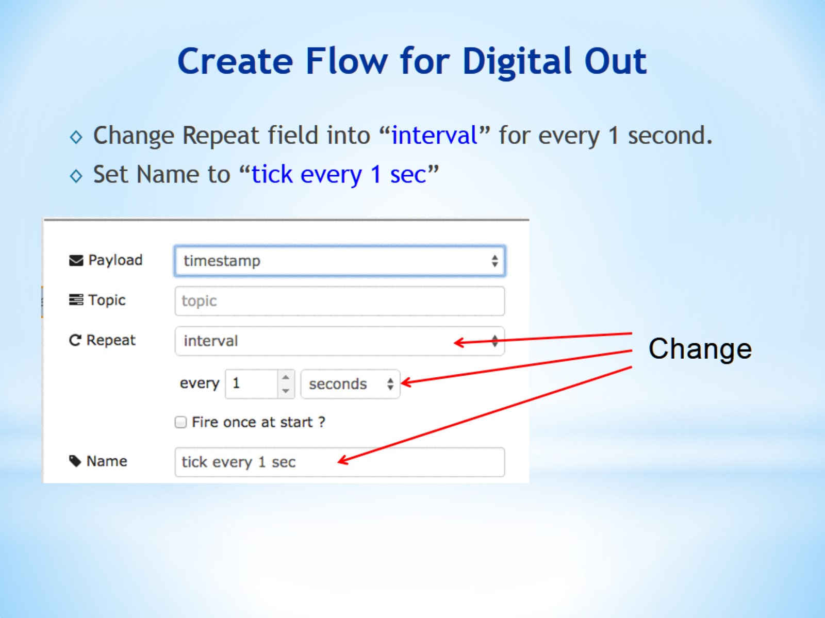
Create Flow for Digital Out

Slide 36
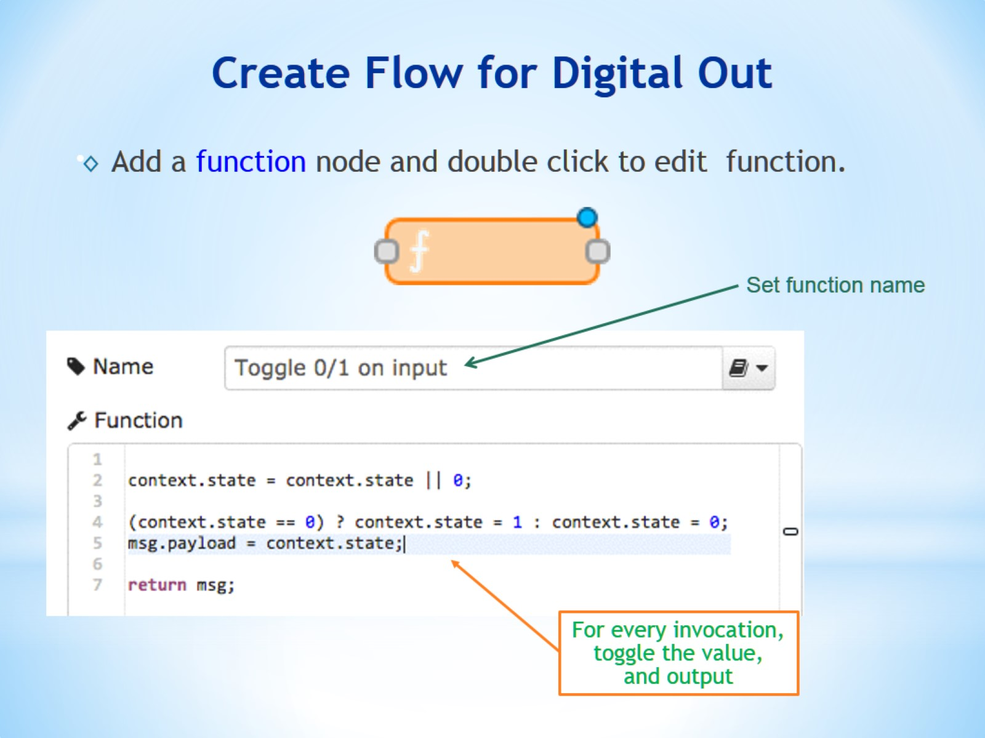
Create Flow for Digital Out

Slide 37
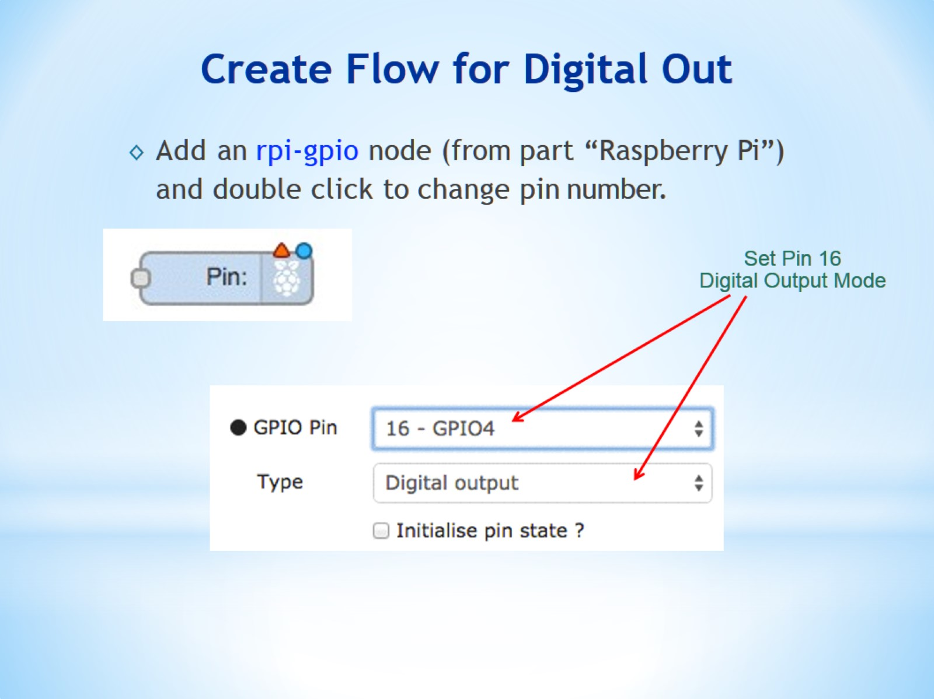
Create Flow for Digital Out

Slide 38
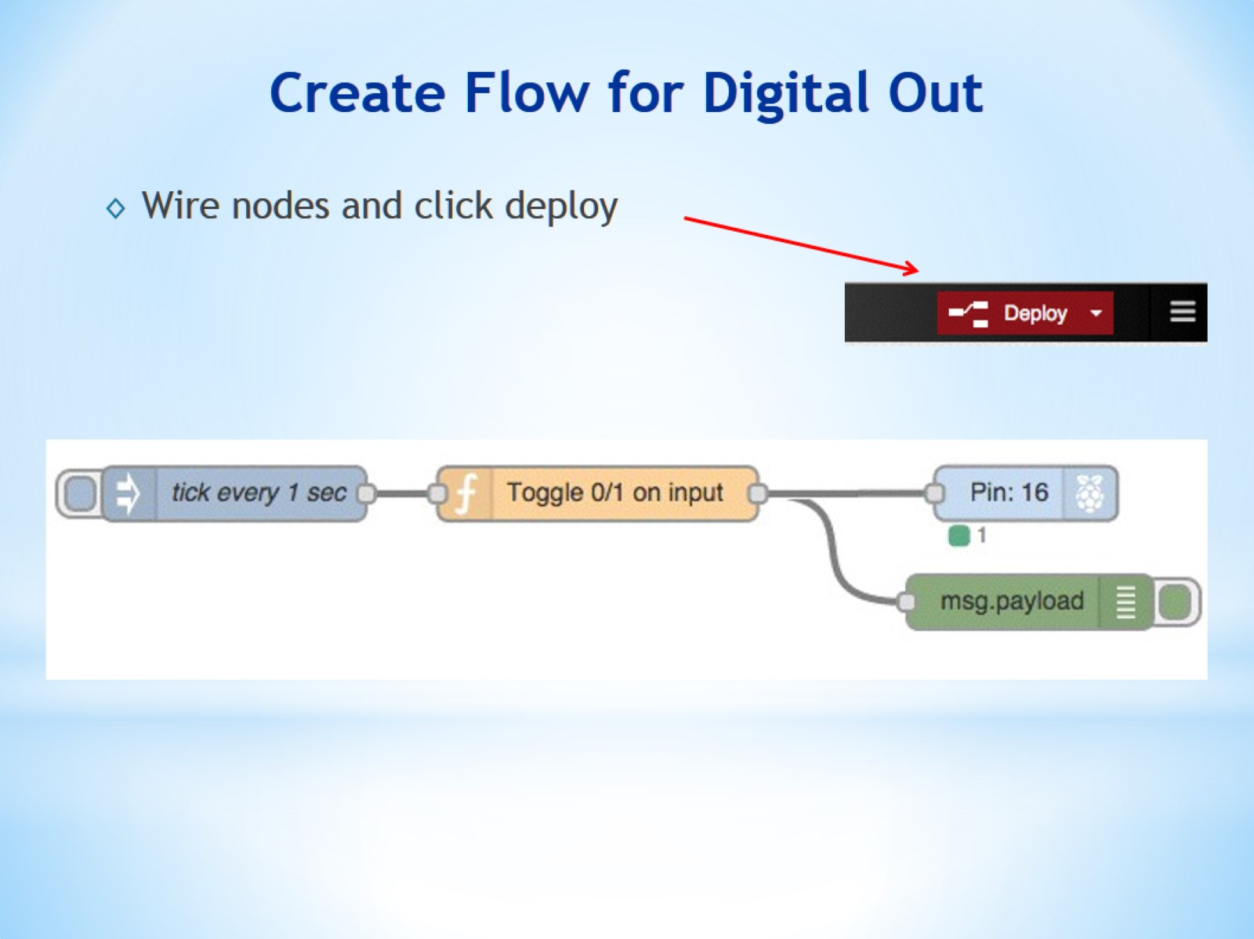
Create Flow for Digital Out

Slide 39
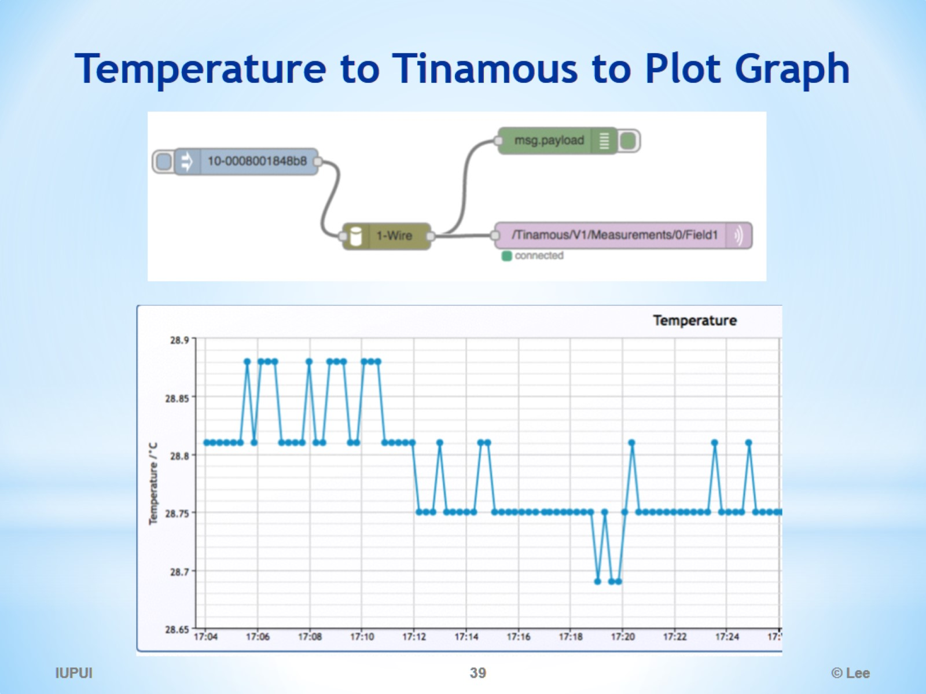
Temperature to Tinamous to Plot Graph

Slide 40
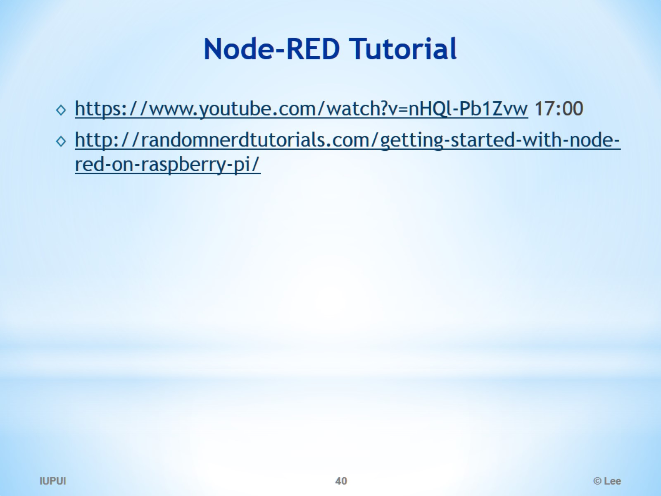
Node-RED Tutorial

Slide 41
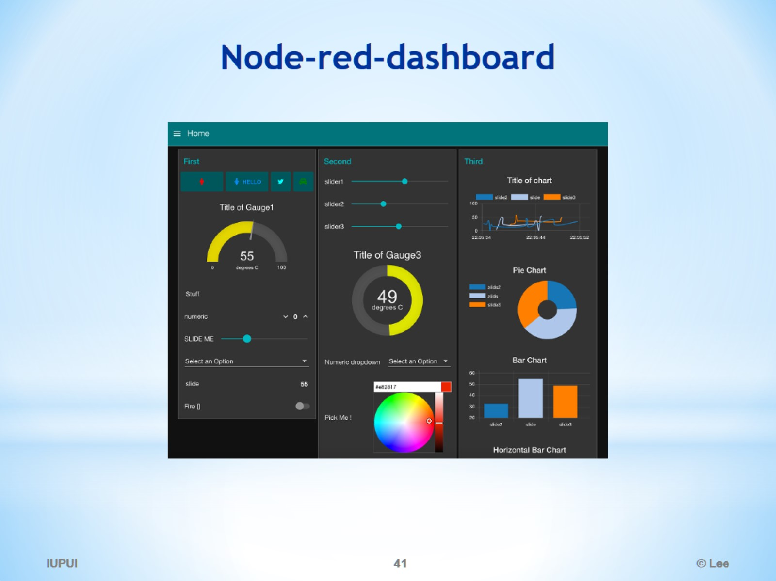
Node-red-dashboard

Slide 42
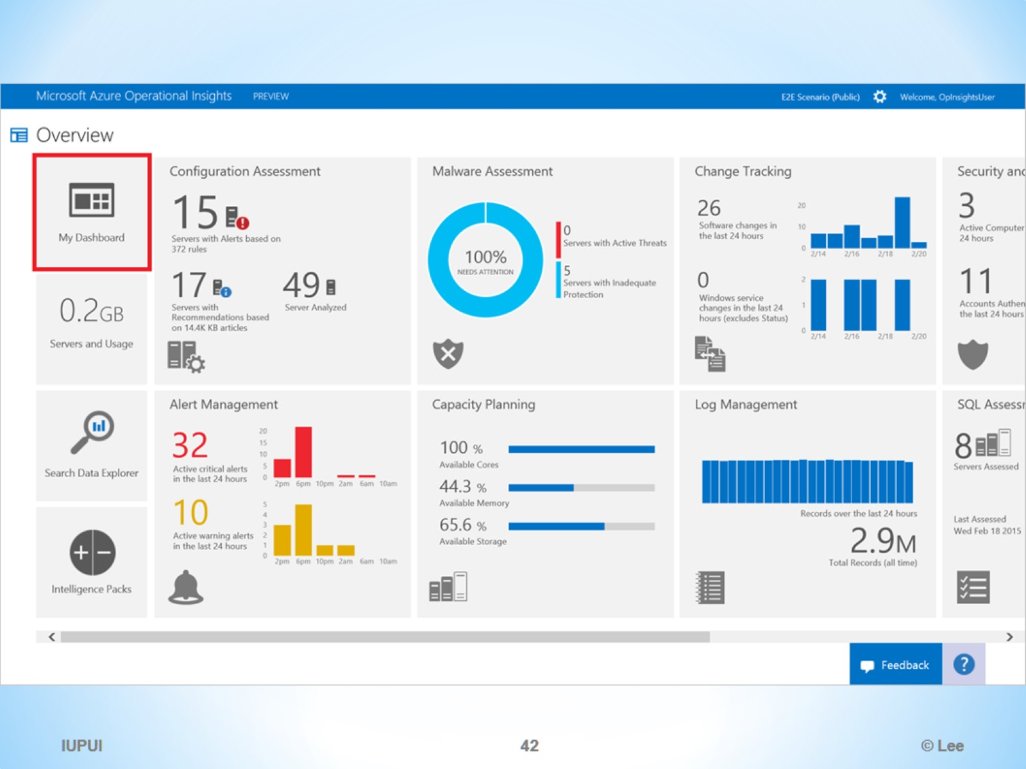

Slide 43
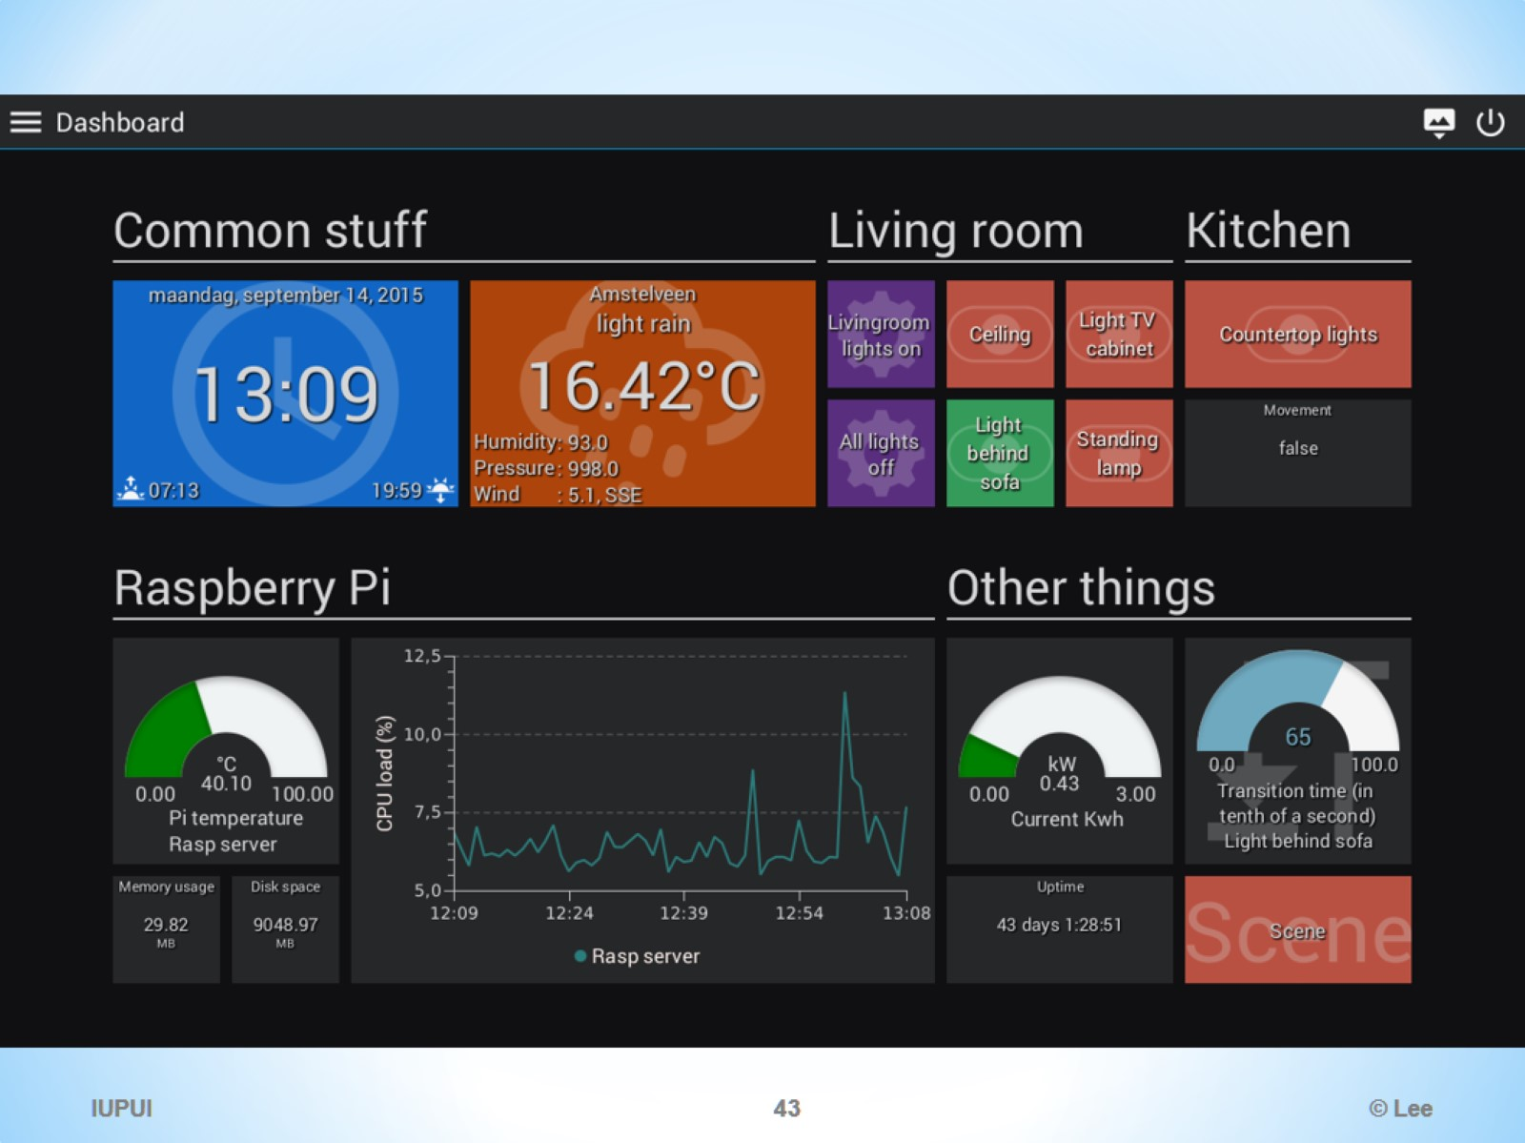

Slide 44
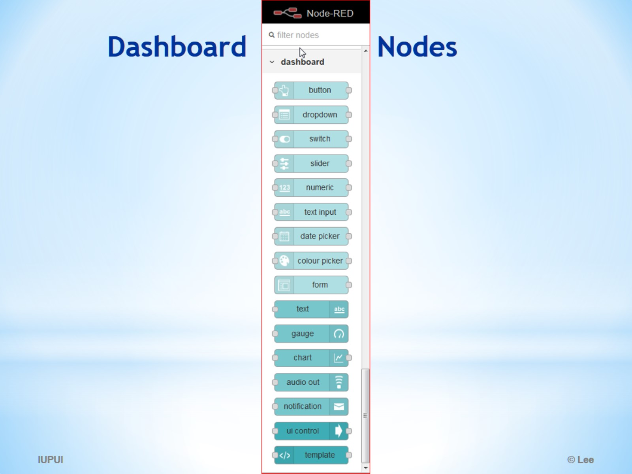
Dashboard Nodes

Slide 45
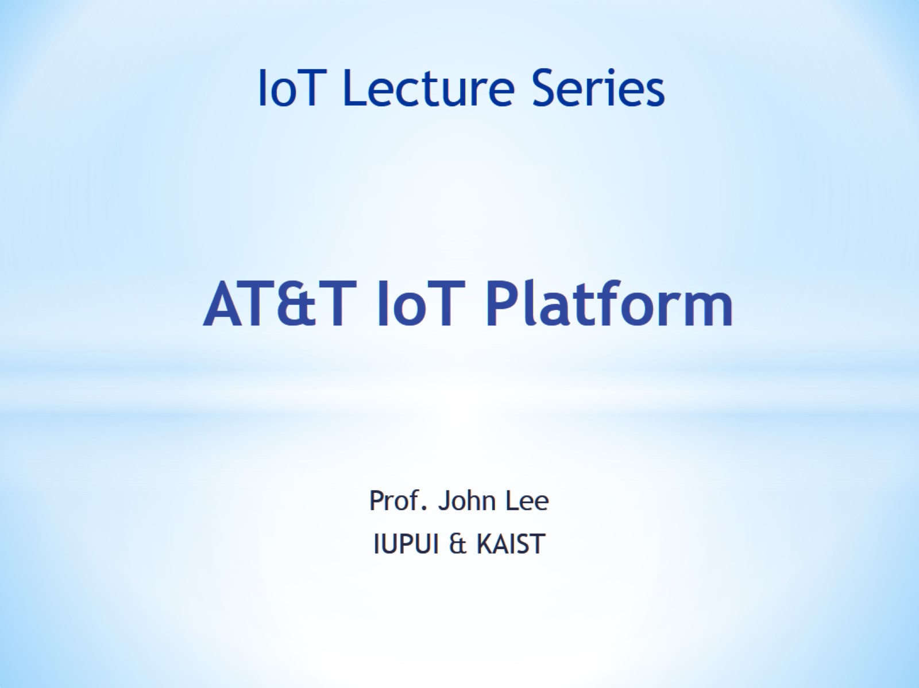
AT&T IoT Platform

Slide 46
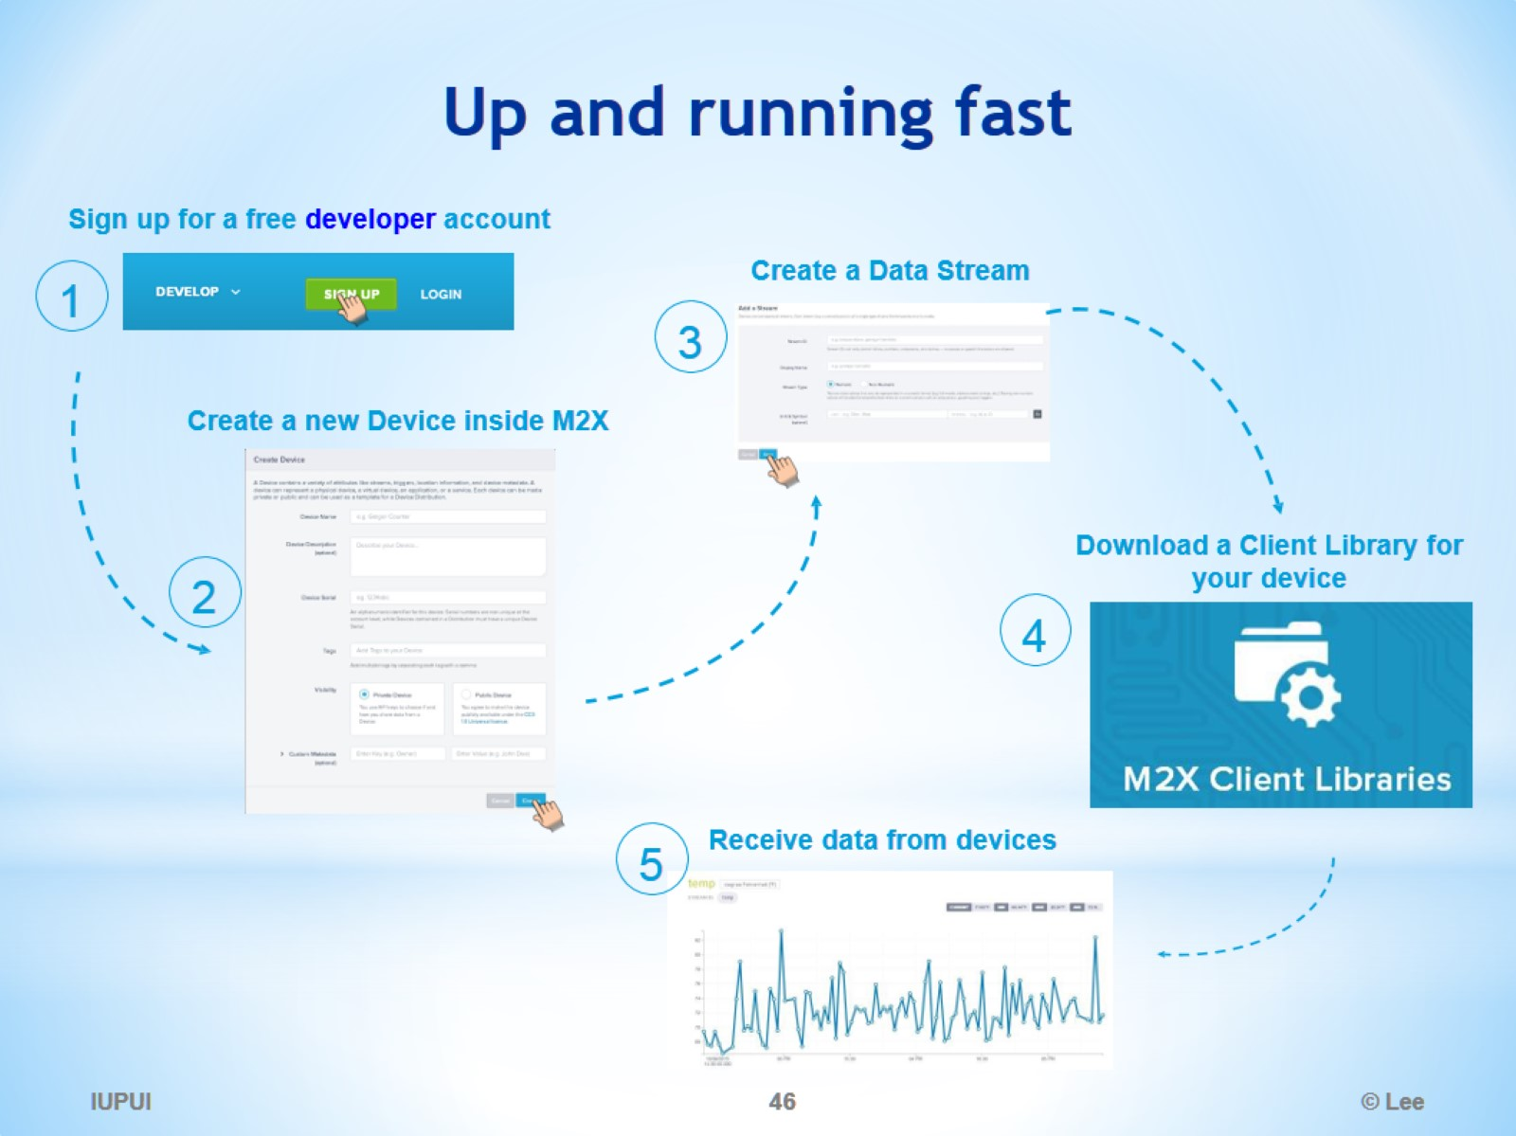
Up and running fast

Slide 47
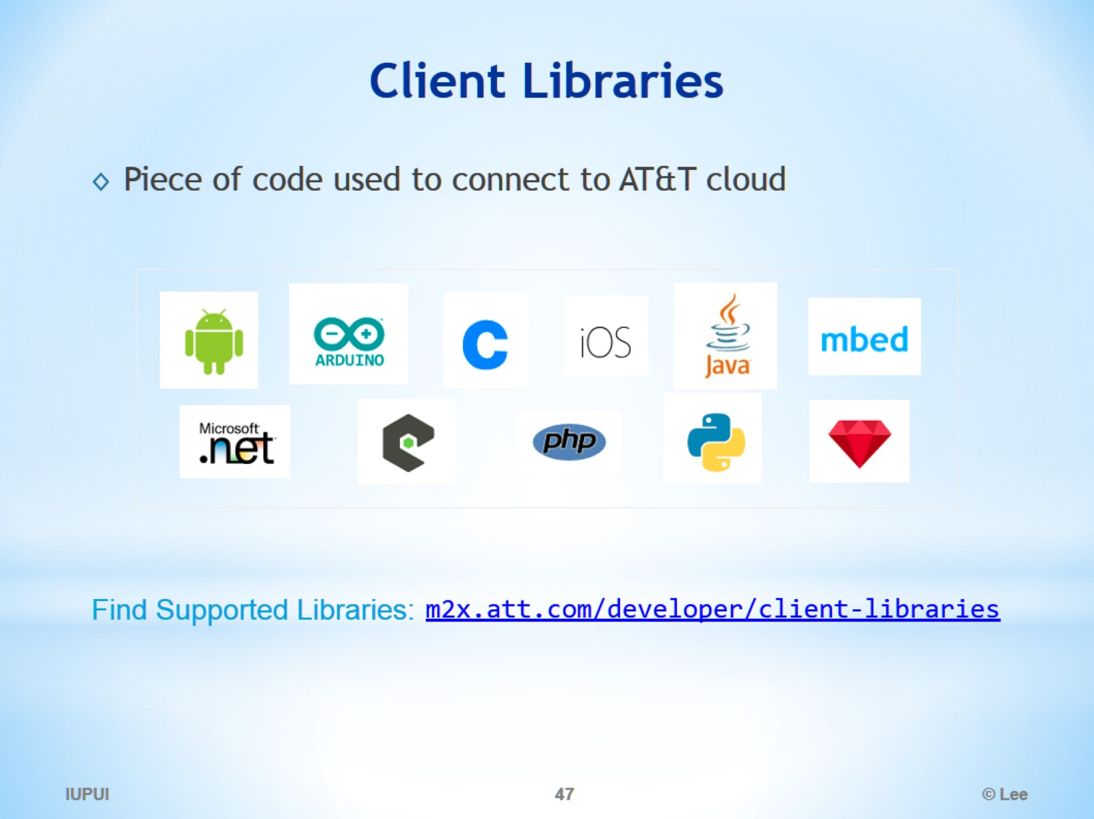
Client Libraries

Slide 48
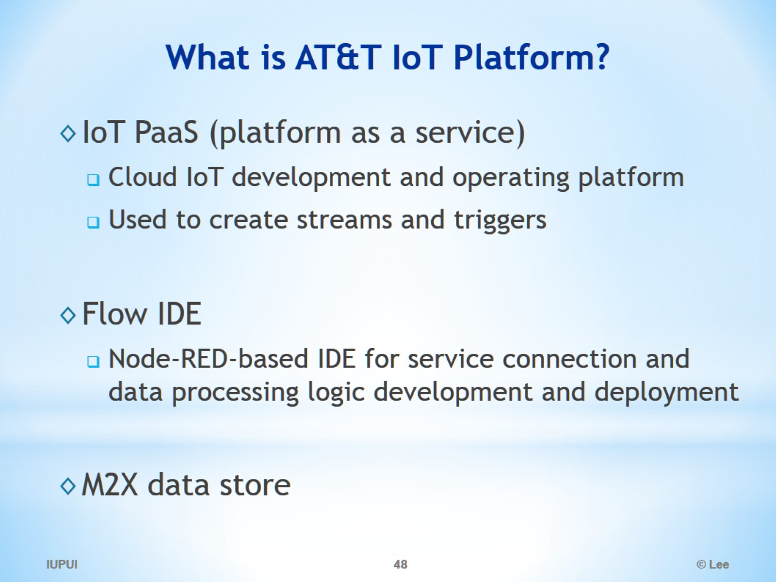
What is AT&T IoT Platform?

Slide 49
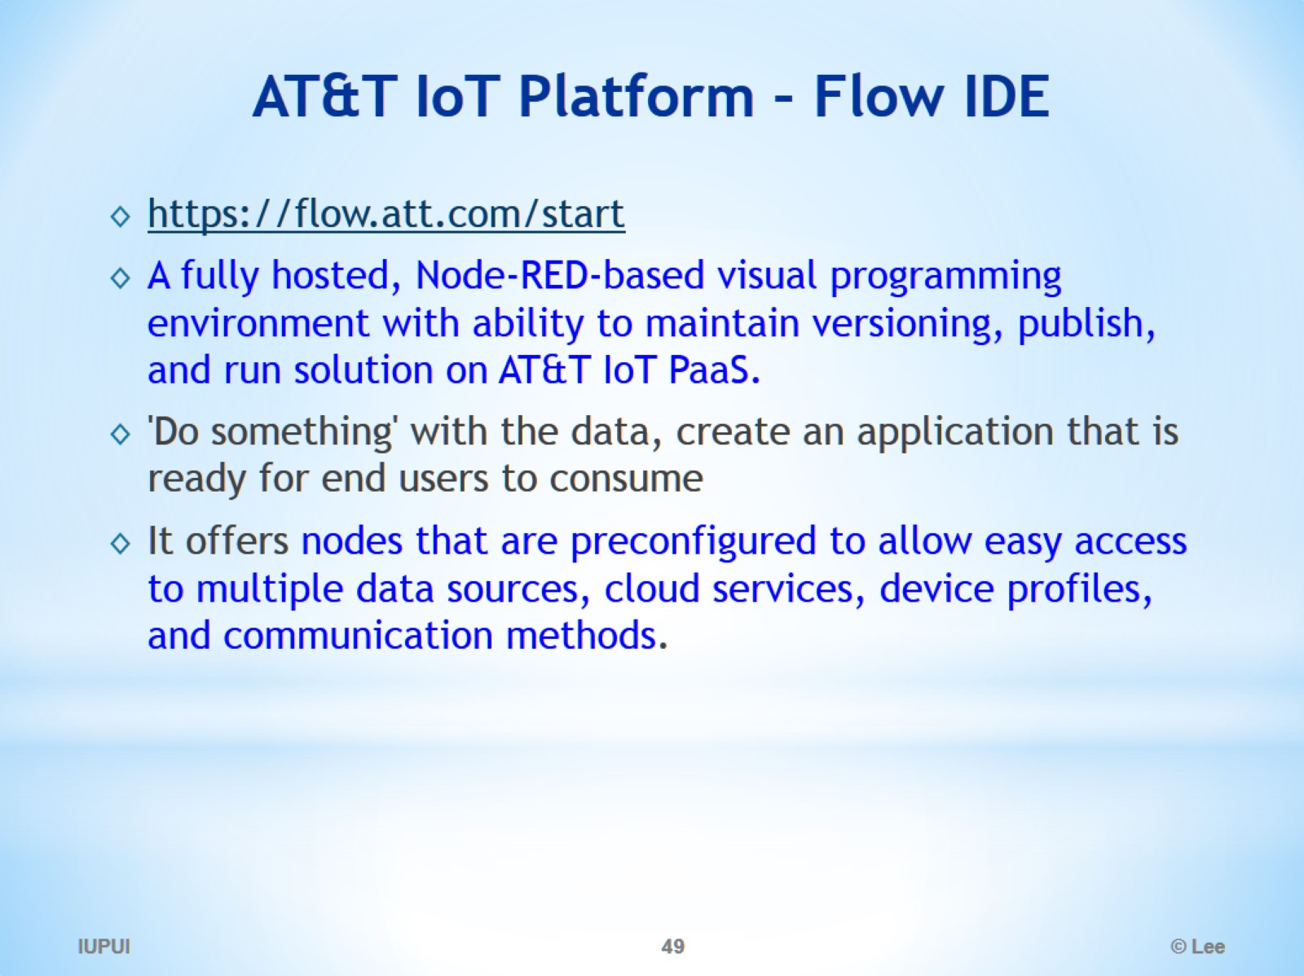
AT&T IoT Platform – Flow IDE

Slide 50
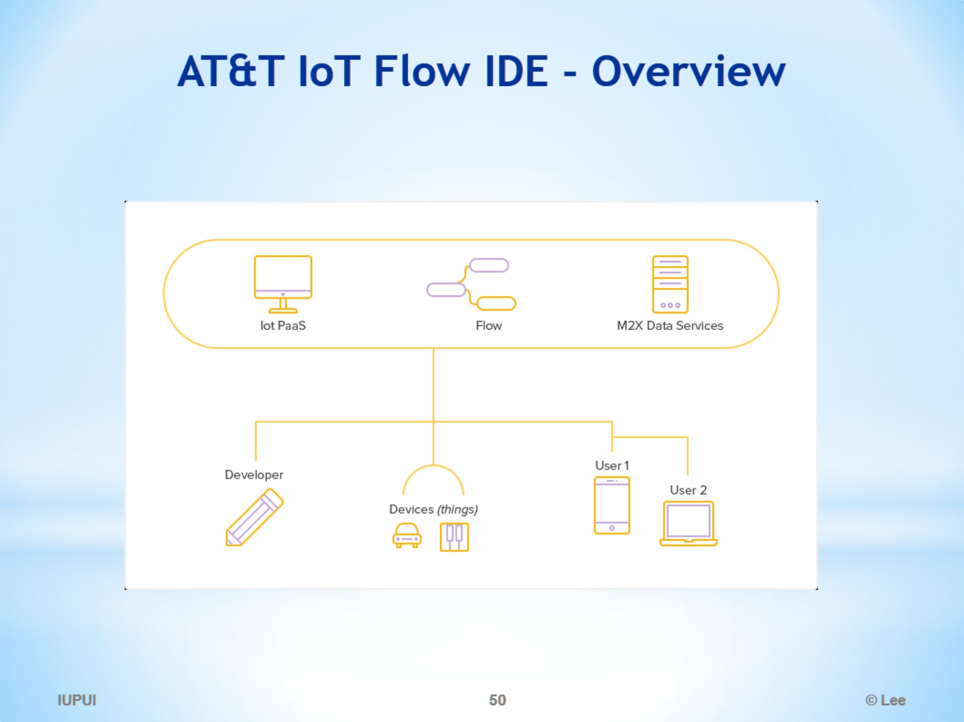
AT&T IoT Flow IDE - Overview

Slide 51

AT&T IoT Flow IDE

Slide 52

Up and running Flow fast

Slide 53


Slide 54

M2X data store

Slide 55

IoT Application Development Platform

Slide 56


Slide 57

Challenge: Building Your IoT Business on the Right IoT Platform

Slide 58

Conventional Application Development is Unable to Unlock the Vast Potential of Smart Connected Products

Slide 59

Ways to Remove Application Bottlenecks

Slide 60

Challenge: Building Your IoT Business on the Right IoT Platform

Slide 61

ThingWorx Platform architecture overview

Slide 62

ThingWorx IoT Platform Technology Simplifies Solution Delivery

Slide 63

Purpose Built for IoT Development

Slide 64

ThingWorx Marketplace™ Magnifies Ecosystem Power

Slide 65

ThingWorx Marketplace (Extension Store)

Slide 66

Unites the Connected World

Slide 67

What Can ThingWorx Do For You?

Slide 68

The ThingWorx Stack

Slide 69

Building Rich Clients

Slide 70

Applications

Slide 71

Manufacturing

Slide 72

ThingWorks - Smart Buildings

Slide 73

ThingWorx - Machine2Machine

Slide 74

ThingWorkx - Complex Machinery

Slide 75

ThingWorkx - Transportation

Slide 76

Smart Traffic Monitoring & Public Safety

Slide 77

Smart Agriculture

Slide 78

Smart Agriculture

Slide 79

Water Monitoring

Slide 80

Structural Monitoring

Slide 81

Connected Vehicles

Slide 82

How can a thing communicate with a cloud ThingWorx server?

Slide 83

Edge Micro-server (EMS)

Slide 84

How can I create my own thing and connect to ThingWorx server?

Slide 85

How can I control output on my device?

Slide 86

Tutorials

Slide 87

Java-based Weather station with Raspberry Pi

Slide 88

Java-based EMS

Slide 89

Weather App with Arduino

Slide 90

Additional Tutorials

Slide 91

The Composer a web-based modeling & development environment

Slide 92

Creating a Mashup (Webpage UI) using the Composer

Slide 93

Mashup (Webpage UI) Builder

Slide 94

Property Configuration Window

Slide 95

Connecting Data Change Event with a Widget (e.g., Checkbox)

Slide 96

Monitoring and taking action on specific events

Slide 97

Creating Complex Rules using JavaScript

Slide 98

Controlling a Property Value using Checkbox - in Mashup -

Slide 99

Creating an Alert on a Property Value

Slide 100

Managing Alert

Slide 101

ThingWorx Composer a web-based modeling & development environment

Slide 102


Slide 103

GUI Composer 구성 요소들

Slide 104

Some ThingWorx Terminology

Slide 105

Terms

Slide 106

Base Thing Templates (page 1/3)

Slide 107

Base Thing Templates (page 2/3)

Slide 108

Base Thing Templates (page 3/3)

Slide 109

Terms

Slide 110

Terms

Slide 111

Project Building Steps

Slide 112

Creating a Thing

Slide 113

Binding Data between a model Thing and real Thing

Slide 114

Property Base Types

Slide 115

Thing—Properties (e.g., temperature)

Slide 116

Value Stream—Properties

Slide 117

What kinds of data processing logic can the platform handle?

Slide 118

Thing—Services Data processing, rules, remote function calls, etc.

Slide 119


Slide 120

Thing—Events For Creating Special Alerts

Slide 121

Thing—Subscriptions for Events

Slide 122

Event Notifier

Slide 123

MailServer—Services

Slide 124

Mashup (Webpage UI) Builder

Slide 125

Web Interface (deployed)

Slide 126

Configurable Properties of Gauge Widget

